Slide 1

Year 2
Curriculum Morning 2026

Slide 2
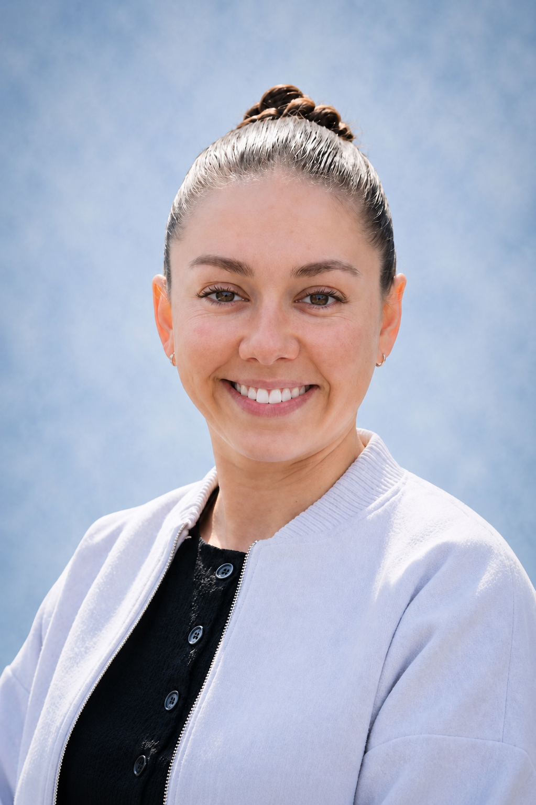
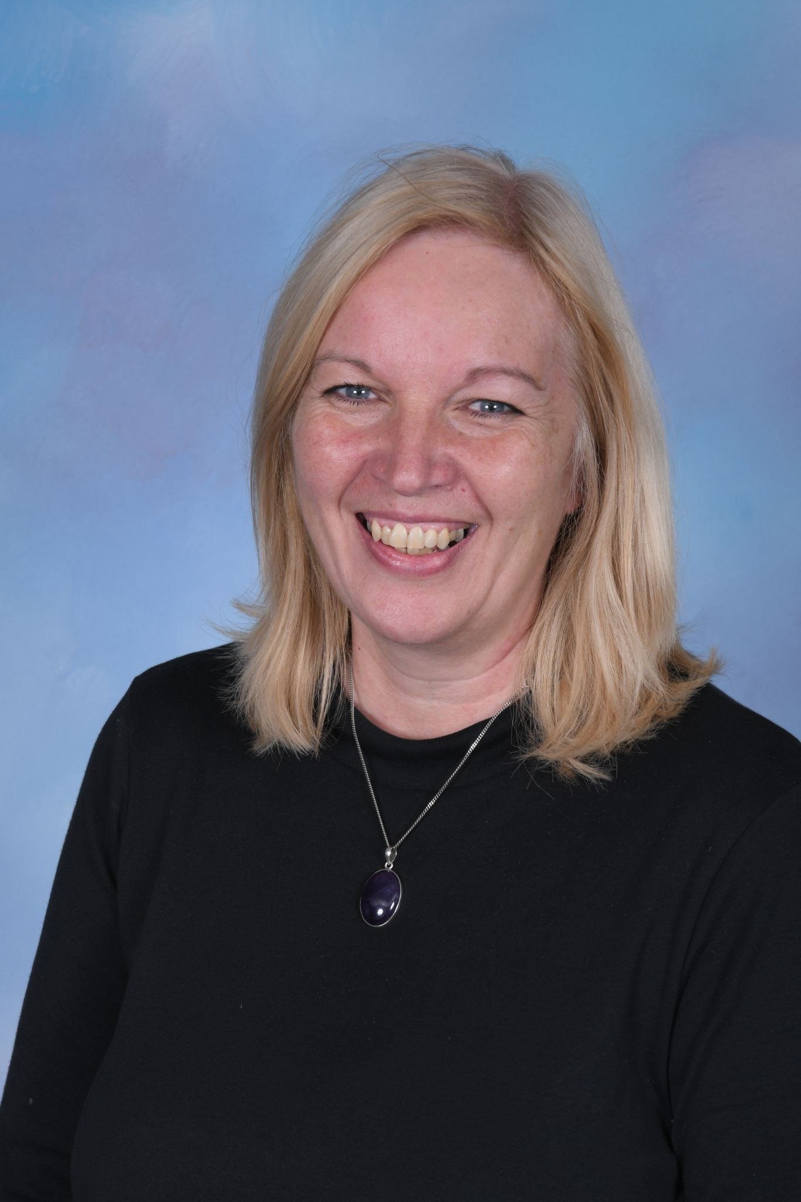
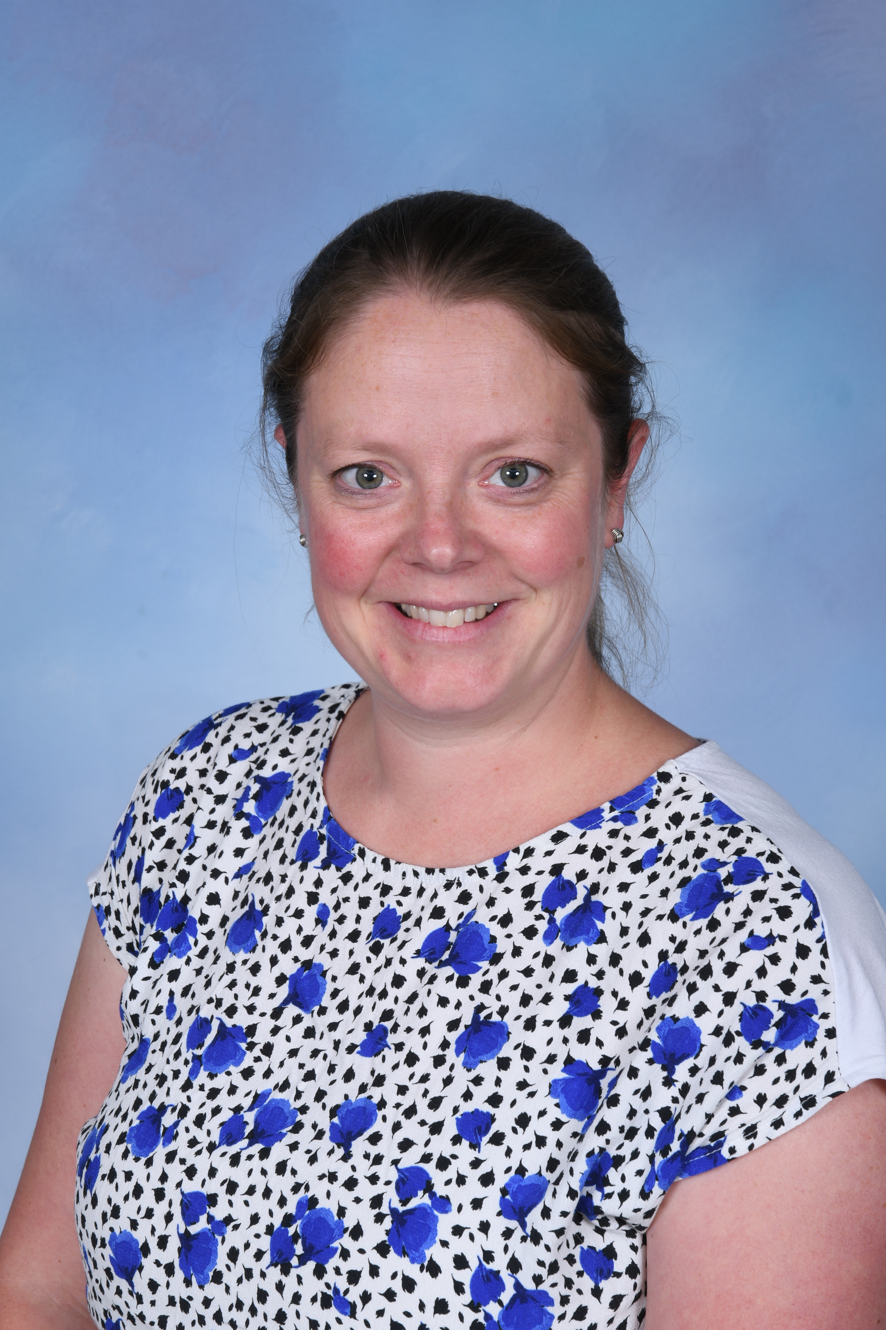
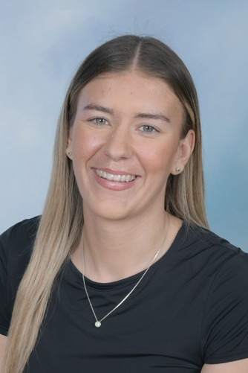
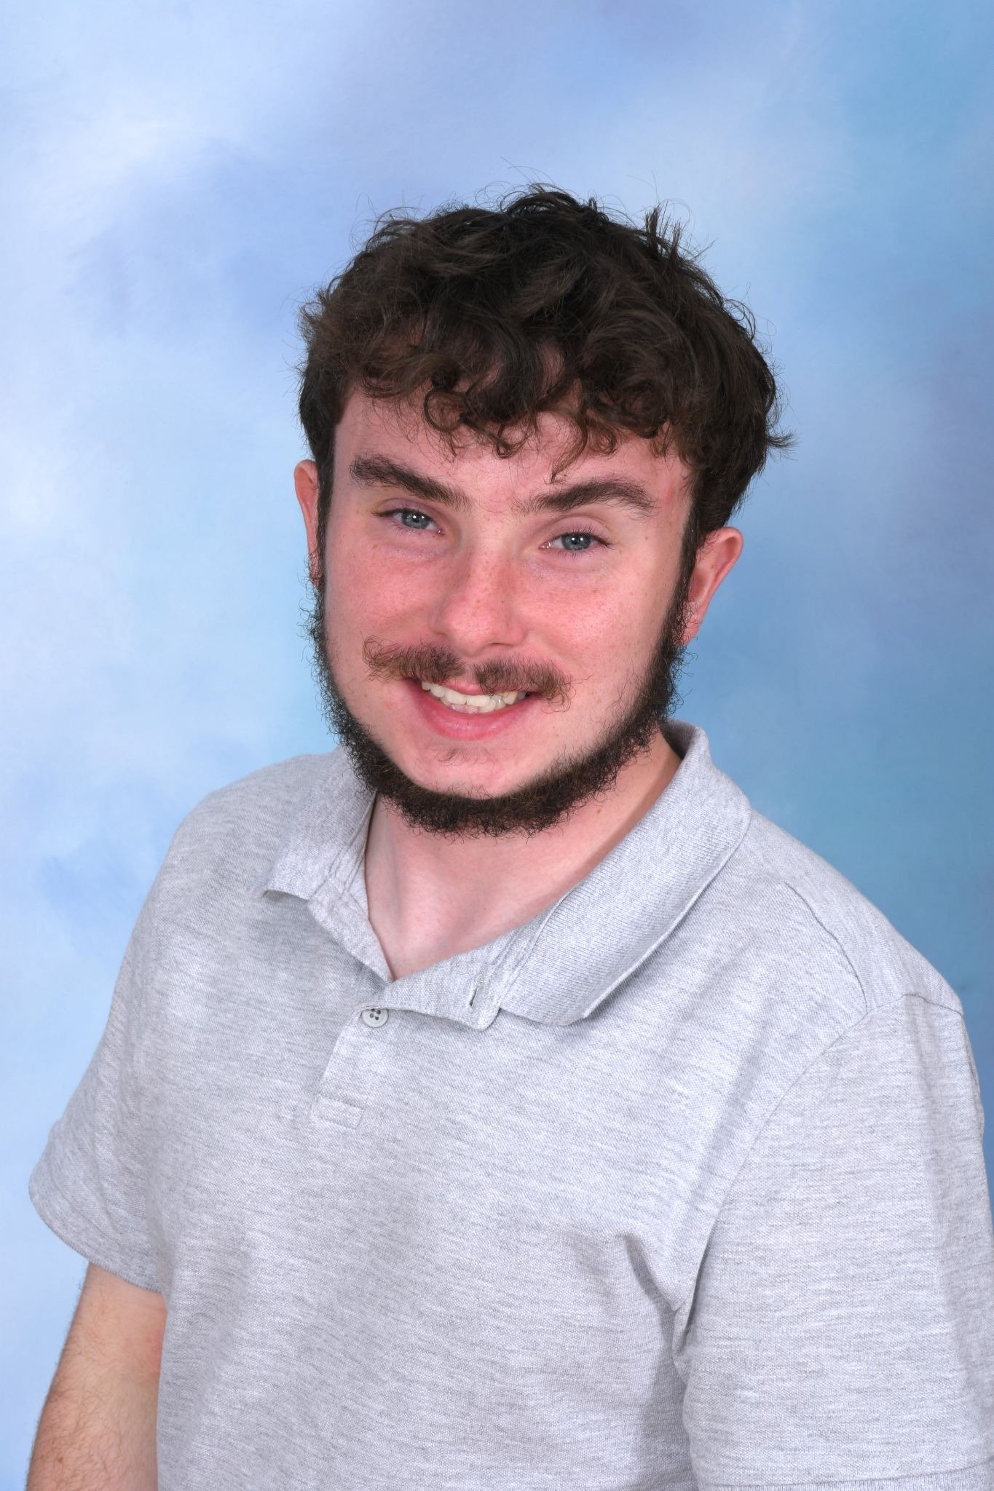
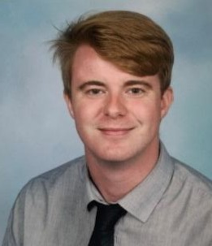
Year 2 Staff
Miss Birch Mrs Brown
(Mornings)
Miss Edwards
Thurs- afternoon
Mrs Mohamed
Mr Harris
(Afternoons)
Mr Sanderson
Alternate Tues- afternoon

Slide 3
Behaviour and Rewards
When a pupil’s behaviour meets, or goes above and beyond, the expected behaviour standard, staff will recognise it with positive recognition and reward. This provides an opportunity for all staff to reinforce the school’s culture and ethos.
Positive reinforcements and rewards will be applied clearly and fairly to reinforce the routines, expectations and norms of the school’s behaviour culture.
Positive behaviour will be rewarded with such things as:
Verbal praise
Dojo Points
Communicating praise to parents/carers
Certificates at Celebration Assembly
Positions of responsibility
Golden Table

Slide 4



Behaviour and Rewards
School wide recognition:
Star of the Week
Growth Mindset
Shout outs
Golden Table
Dojos
Year 2 specific:
-Dojo VIP
-Table ticks

Slide 5
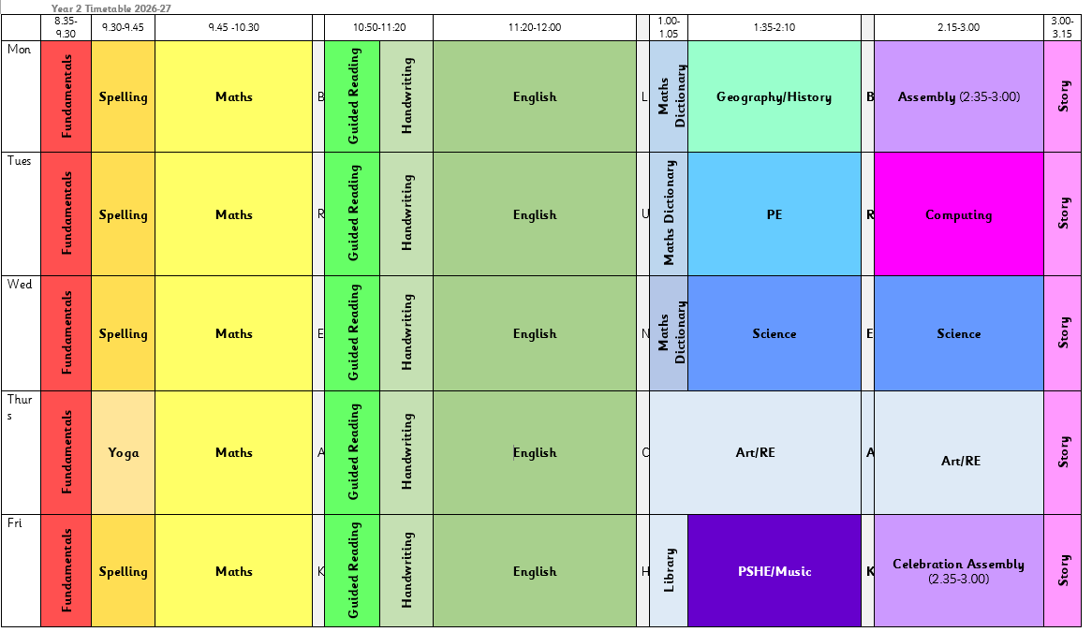
Typical Day

Slide 6
Important Days
PE- Every Tuesday
Homework- given out of Fridays, due back in Thursdays
Library- Fridays, due back in Thursdays
Celebration Assembly- Friday (invitation only)

Slide 7
Home Reading
Reading is essential for children's development as it lays the foundation for all future learning. It builds vocabulary, improves comprehension, and enhances critical thinking skills, which are crucial across all subjects. Reading also stimulates imagination, fosters empathy by exposing children to diverse perspectives, and strengthens their ability to focus and concentrate.
Additionally, early reading habits have been shown to lead to better academic performance and a lifelong love of learning. By encouraging reading, parents help their children develop the skills and curiosity needed to succeed in school and beyond.
Children should read aloud to an adult a minimum of 3 times a week.
Ask your child questions about what they have read.
Encourage your child you use their phonics to de-code if necessary.
Read for pleasure.

Slide 8
Homework
Read with an adult x3 – record in yellow reading record.
MyMaths- 1 session set based on class learning
TTRS- once times tables have been learnt

Slide 9
Big Questions
Autumn
Does it matter how you get there?
Spring
What brings a city together?
Summer
Does the world need saving?

Slide 10

Curriculum Information
https://www.brookdaleprimaryschool.co.uk/

Slide 11
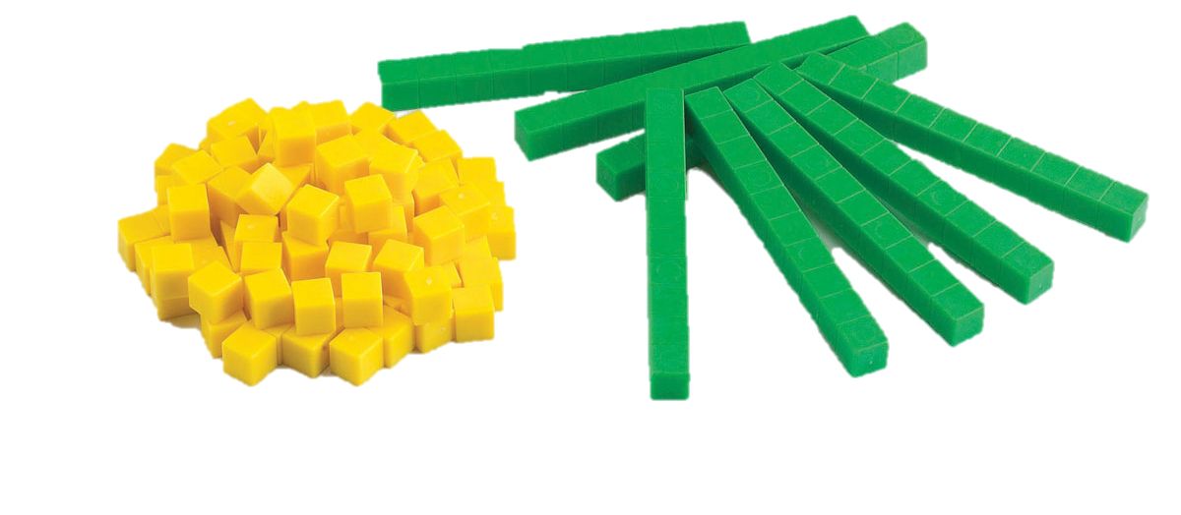
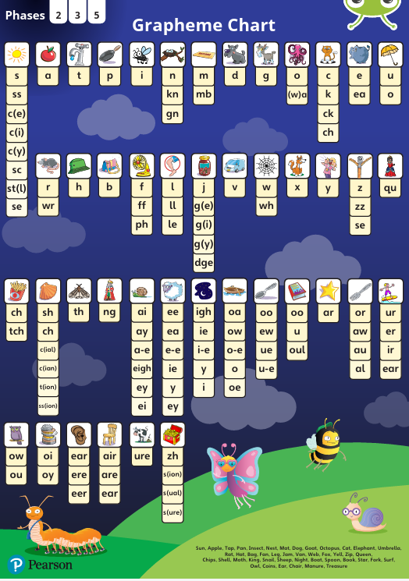
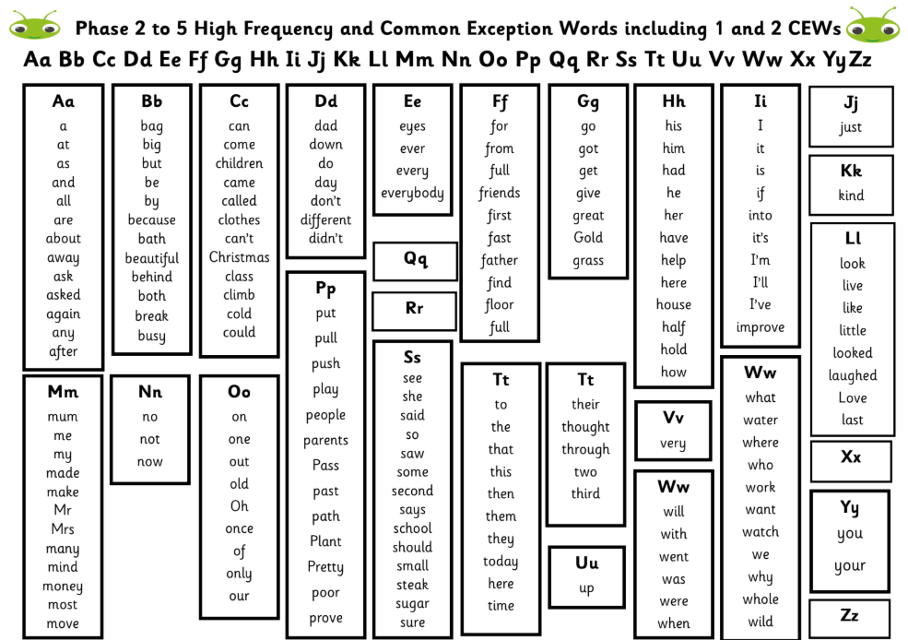
Adapting Learning to Support Your Child
Word mats / books
Working walls
Scaffolding- chunked learning
Equipment
Universal Adaptations- https://www.brookdaleprimaryschool.co.uk/Learning/SEND/
If a child is not able to access learning despite all of these adaptations, they will have a learning support plan managed by the class teacher and the SENCo to support their learning further.

Slide 12

PSHE/RSE
Fire safety Petty Arson
Texting Whilst Driving
Keeping/ Staying safe Tying Shoelaces | Keeping/Staying Healthy Healthy Eating | Relationships Bullying | Being Responsible Practice Makes Perfect | Feelings & Emotions Worry | Computer safety Image Sharing | Our World Living in Our World
 | Brushing Teeth | Body language | Helping Someone in Need | Anger | Documentary | Working in Our World
Materials can be accessed at: https://www.1decision.co.uk/resources/parent-carer-zone

Slide 13
Fundamental Skills
In each year group we ensure children understand and can apply the most fundamental skills before they move on to the next stage of learning. Otherwise any future learning will be like ‘building on sand’.
For some children this means that they will need to revisit and receive additional intervention to help them master skills from previous year groups.
https://www.brookdaleprimaryschool.co.uk/English/

Slide 14
Maths
read scales in divisions of ones, twos, fives and tens
partition any two-digit number into different combinations of tens and ones
add and subtract any 2 two-digit numbers using an efficient strategy
recall all number bonds to and within 10 and use these to reason with and calculate bonds to and within 20, recognising other associated additive relationships – for example: if 7 + 3 = 10, then 17 + 3 = 20
recall multiplication and division facts for 2, 5 and 10 and use them to solve simple problems, demonstrating an understanding of commutativity as necessary
identify 1/4, 1/3, 1/2, 2/4, 3/4 of a number or shape, and know that all parts must be equal parts of the whole
use different coins to make the same amount
read the time on a clock to the nearest 15 minutes
name and describe properties of 2D and 3D shapes, including number of sides, vertices, edges, faces and lines of symmetry

Slide 15
Maths Journal Example

Slide 16
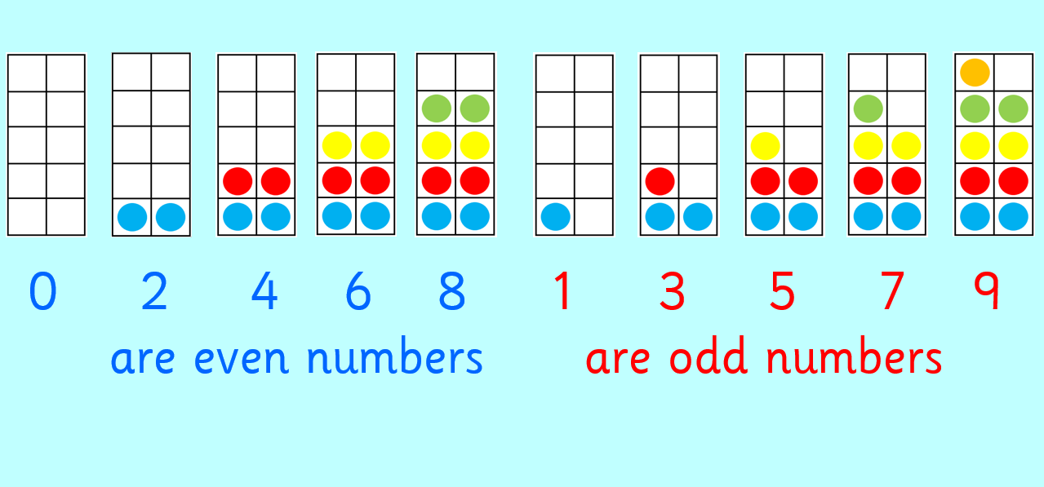
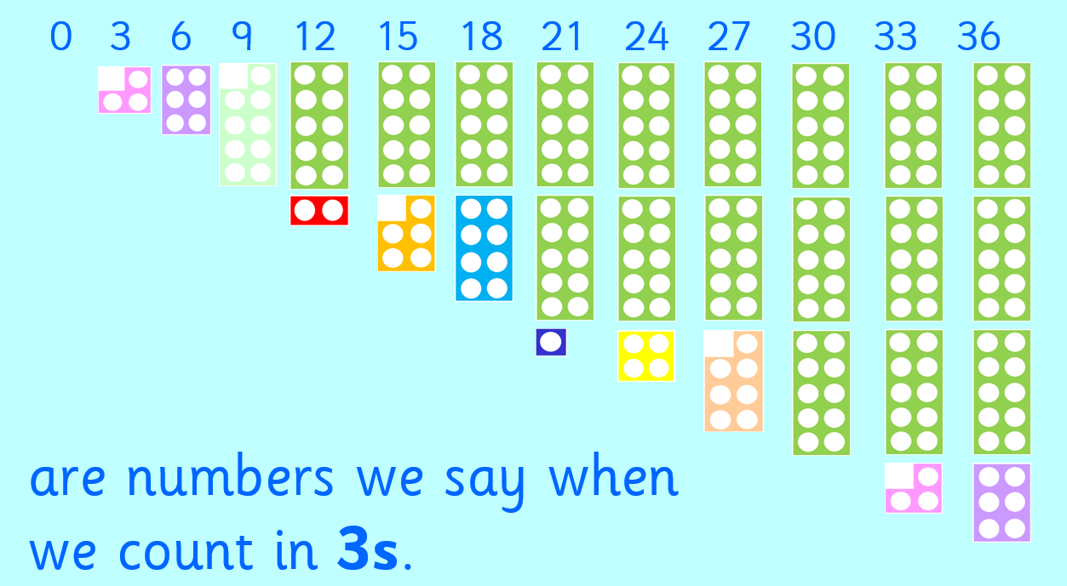
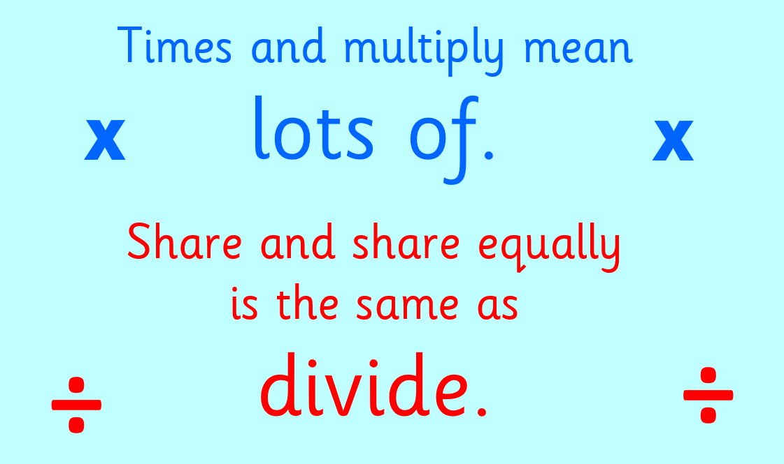
Maths Dictionary

Slide 17
English - Writing
Writing/GPAS
write simple, coherent narratives about personal experiences and those of others (real or fictional)
write about real events, recording these simply and clearly
demarcate most sentences in their writing with capital letters and full stops, and use question marks correctly when required
use present and past tense mostly correctly and consistently
use co-ordination (such as or/and/but) and some subordination (such as when/if/that/because) to join clauses
segment spoken words into phonemes and represent these by graphemes, spelling many of these words correctly and making phonically plausible attempts at others
spell many common exception words

Slide 18
Writing Example

Slide 19
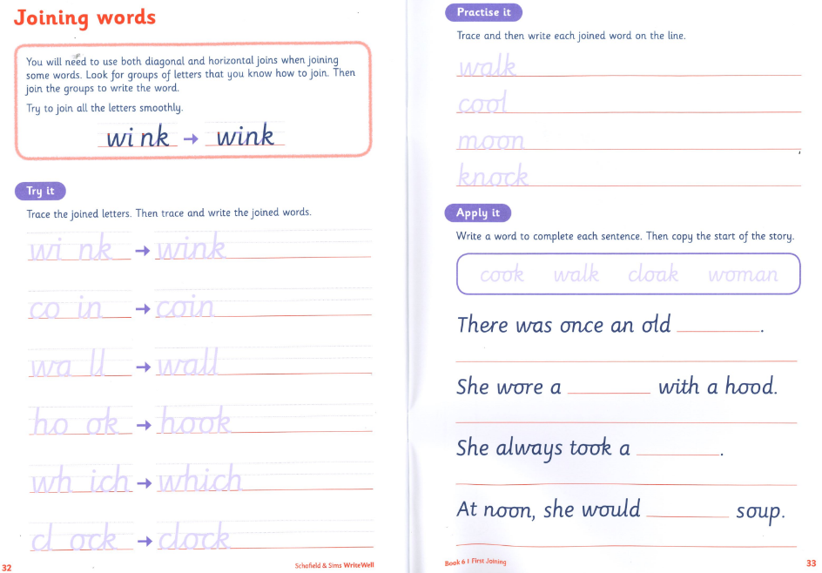
Handwriting
form capital letters and digits of the correct size, orientation and relationship to one another and to lower-case letters
use spacing between words that reflects the size of the letters
Handwriting scheme- explicitly taught.
Aim to begin joining by the end of Year 2.

Slide 20
Assessment
We assess the children in:
Writing
Reading comprehension
Grammar and spelling
Maths
Science
These areas are assessed throughout the year with outcomes used by teachers to inform next steps in their teaching.
One assessed piece of writing each half term
During each term: Maths, Reading and GPAS (Grammar, Punctuation and Spelling) tests.
End of Year 2- KS1 SATS non-statutory
Access arrangements

Slide 21

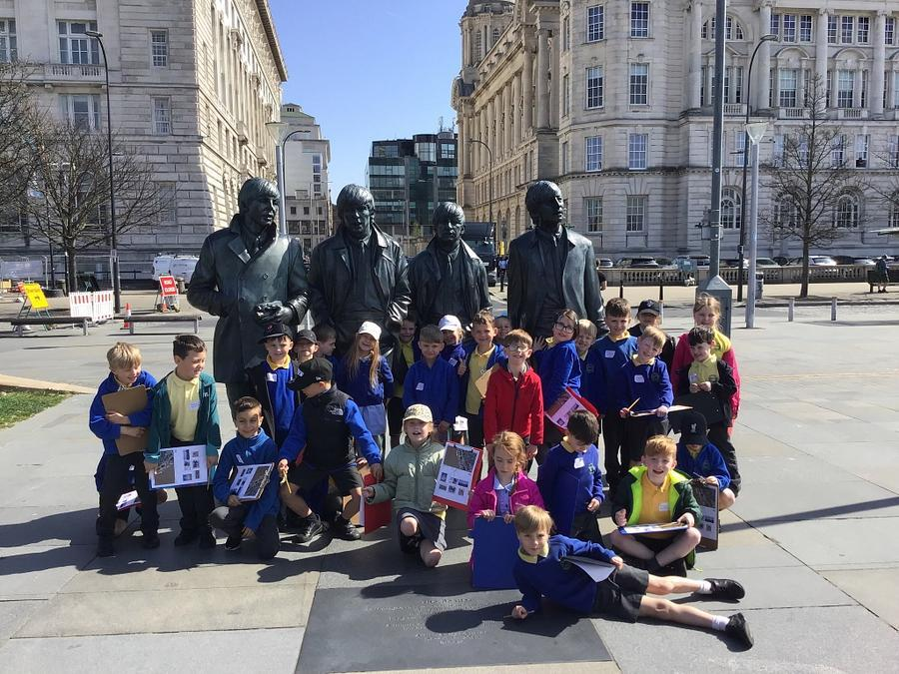
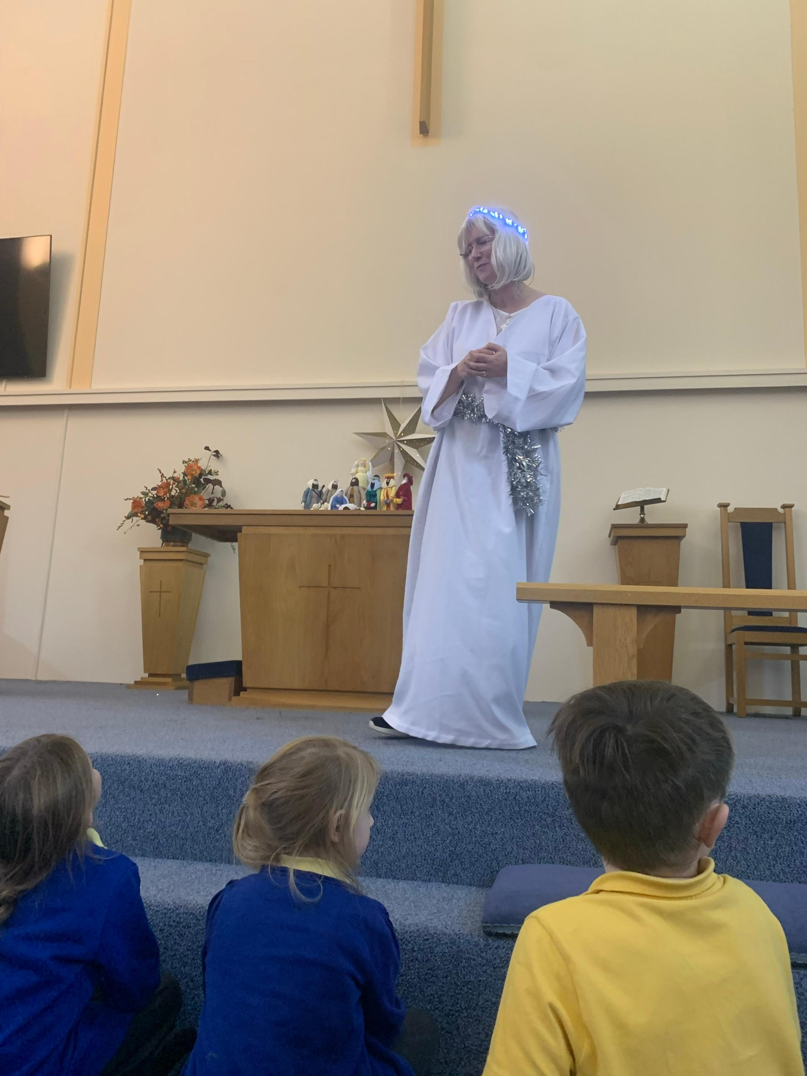
Trips
Hope Journey (Autumn)
Liverpool (Spring)
Hilbre Island (Summer)
Parents will be informed via email about a big class trip a few weeks before it is due to happen and how to make payment.

Slide 22
Teaching Session
Spelling- use of phonics and spelling rules
encourage children to break down phonemes (sounds) in words, then try to match these to the correct graphemes (letters)
encourage children to recognise any spelling patterns

Slide 23
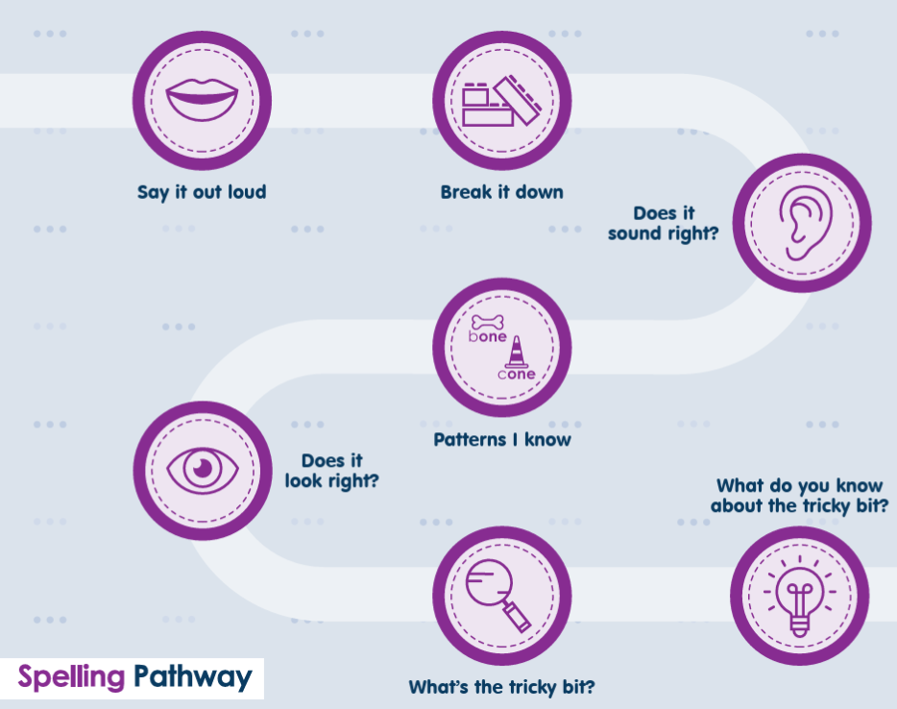

Slide 25
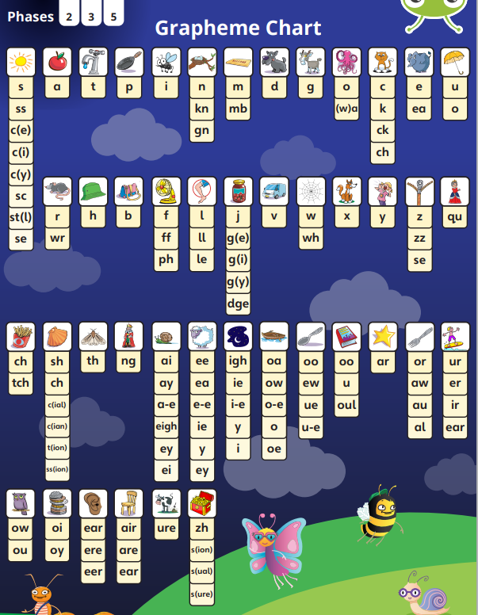
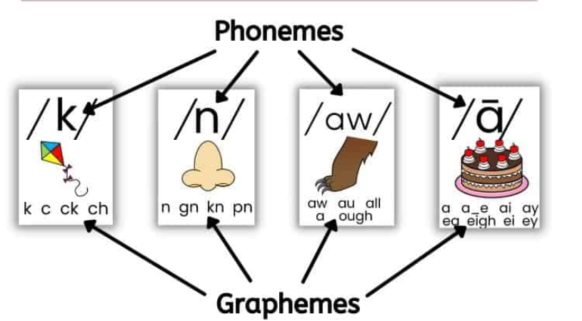
s
k
y

Slide 26
very
happy
funny
party
mighty
sorry
worry
silly
carry

Slide 27
cry
fly
dry
try
reply
sky
July
shy
fry
sly
What is the end grapheme?
What is the final phoneme?
What is the same/different as the words from yesterday?

Slide 28
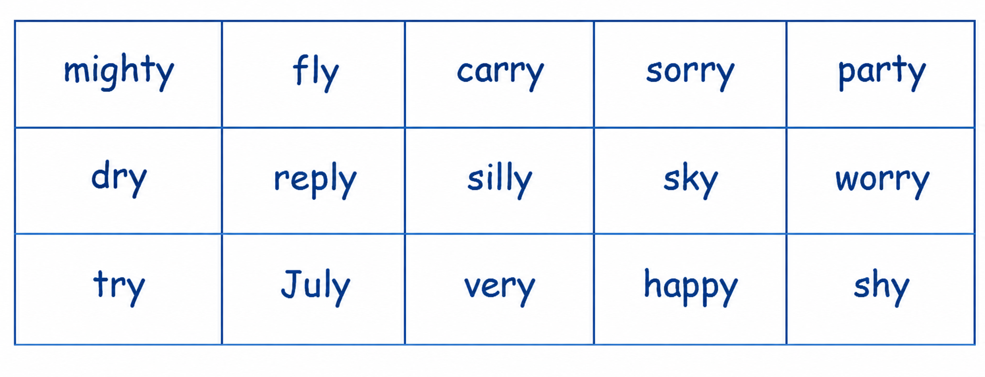
y→ ‘ee’
y→’igh’

