Slide 1

Welcome to our Year 1 curriculum morning.

Slide 2
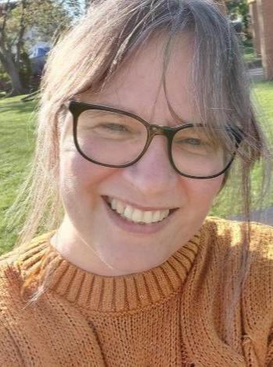
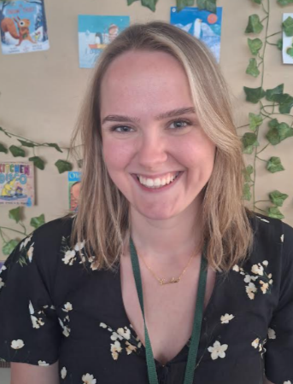
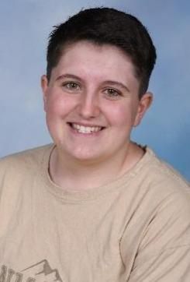
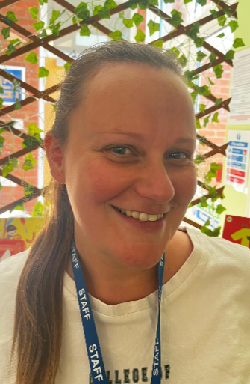
Year 1 Staff
Mrs Kirk
Mrs Jackson
Miss Mullen
Miss Scourfield

Slide 3

School Vision Statement
Inspiring, engaging and nurturing our children to achieve and
flourish as citizens of today and the future.
Attitudes & Effort
At Brookdale, we encourage our children to work hard and to always try their best. We instil the message that it is OK to struggle, be stuck and to make mistakes; it is the way they become ‘unstuck’ that matters.
Notes:
AJ

Slide 4





Behaviour and Rewards
School wide recognition:
Star of the Week - certificate in assembly
Growth Mindset - certificate in assembly
Shout outs - assembly (ambassadors & Mrs Ball)
Golden Table - dinner time
Dojos
Golden
Table
Year 1 specific:
-Growth Mindset bear
Star of the week bear
-Brag tag
I
showed
Notes:
AJ

Slide 5

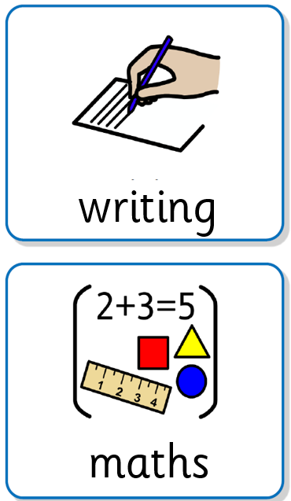
Typical Day
8.35 to 8.45 am drop off
Children come in to do a morning task – reviewing previous work, practising handwriting or phonics, playing maths game to practise skills.
A visual timetable is up in the classroom
Mornings: Phonics, maths, science, English
Afternoons: Reading, RE, PSHE, Geography, History, Science, Music
Whole class work, small group work and individual work take place during the day
In Year 1, we use Busy Time to help the children transition from F2 to more formal learning. This purposeful time helps to build social, problem solving and fine motor skills, and provide the children with opportunities to revisit their learning
Notes:
KK

Slide 6
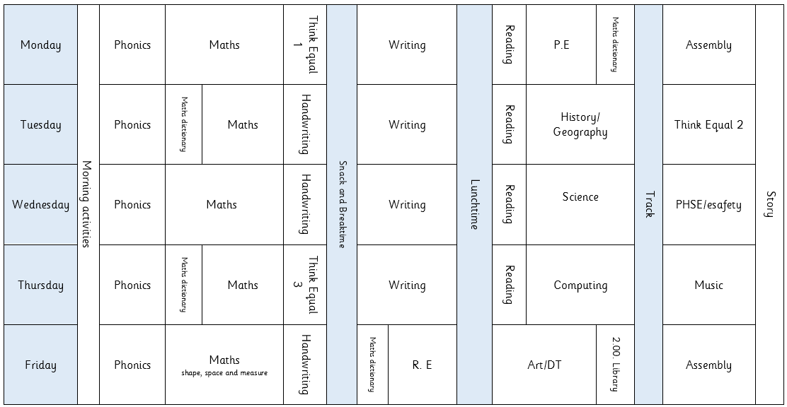
Notes:
KK

Slide 7


Important Days
Monday – P.E
Thursday – Home reading books to be collected in
Friday – Library
Reading books to go home
Celebration Assembly (invitation only)
Notes:
AJ

Slide 8

Home Reading
Reading is essential for children's development as it lays the foundation for all future learning.
It builds vocabulary, improves comprehension, and enhances critical thinking skills, which are crucial across all subjects.
Reading also stimulates imagination, fosters empathy by exposing children to diverse perspectives, and strengthens their ability to focus and concentrate.
Notes:
KK

Slide 9


Home Reading
Each week your child will bring home 2 books. One book will have been read during Guided Reading. The other will be new to your child.
The books that are brought home will link closely to the phonic phase your child is at
Children should read aloud to an adult a minimum of 3 times a week.
Help us celebrate your child’s progress by recording
in their yellow reading records.
Notes:
KK

Slide 10

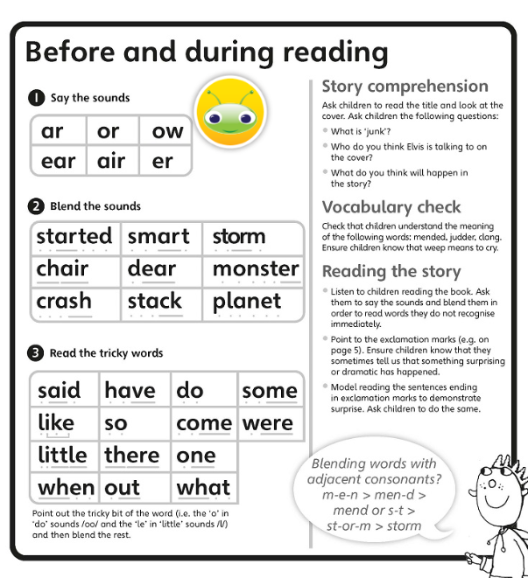
These are the phonemes that we will find in the book.
These are some of the words that appear in the book.
Look at words. Can you see any digraphs? What can you see? Can you see the /ar/?
Break down into phonemes to soundtalk
e.g. /ch/ /air/ - chair
/st/ /a/ /ck/ - stack
Search the book for words containing a certain phoneme/a specific word.
What is a stack?
Notes:
KK

Slide 11
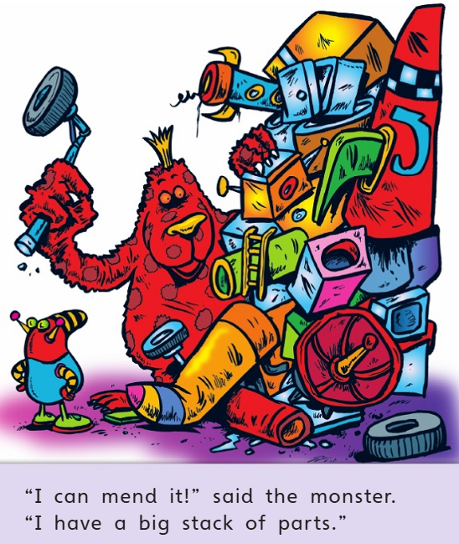
2. Talk about the front cover, share title and read blurb.
What do you think this book will be about?
3. Look through pictures together to try and tell the story.
What can you see? What do you notice? What do you think is happening?
Notes:
KK

Slide 12
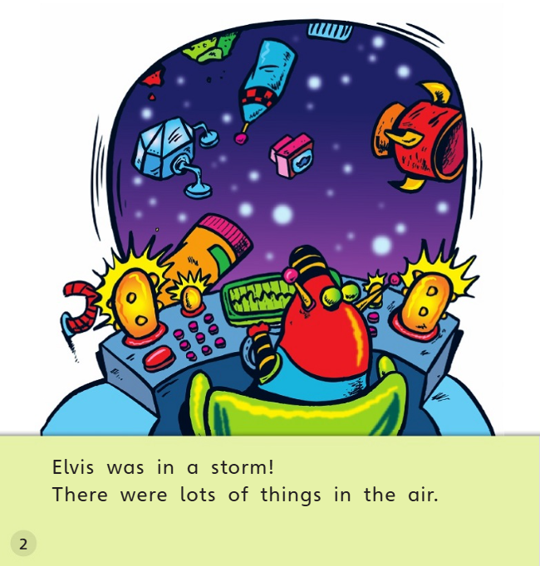
4. Read together if it is a struggle, and then ask your child to try again with more independence.
Lots of smiles/praise…I like the way you…..
5. Move onto next page and repeat until you feel your child needs a break.
6. When your child has achieved independence in their reading, look at intonation.
When does a text need to be whispered, exclaimed, slower or faster? Maybe try voices for characters. Are they using the punctuation?
The most important thing is to enjoy reading experiences, talking about characters and what is happening. If your child is positive about reading, it unlocks all of the curriculum for them.
Notes:
KK

Slide 13
Home Reading
Early reading habits have been shown to lead to better academic performance and a lifelong love of learning.
By encouraging reading, you help your child to develop the skills and curiosity needed to succeed in school and beyond.
Notes:
KK

Slide 14
Big Questions
‘Big’ questions overarch each term within each year group. In order to answer the questions, children will need to draw upon the
knowledge, skills and understanding gained throughout the term
Summer Term
Is there a place
for everything?
Spring Term
Does everyone
feel the same?
Autumn Term
How can we make
others welcome?
Notes:
AJ

Slide 15
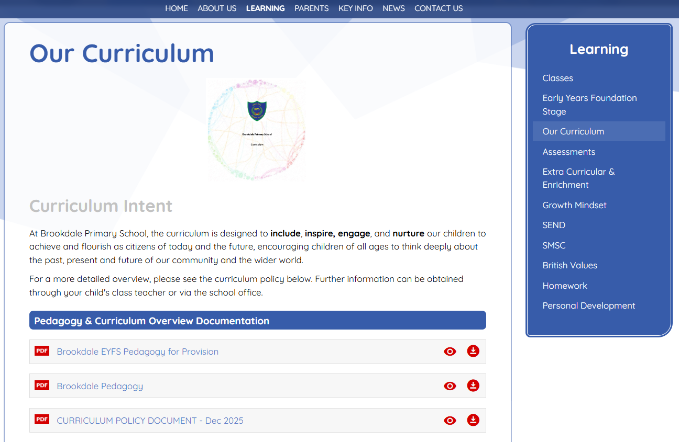
The Brookdale Primary School Website has all our curriculum information
https://www.brookdaleprimaryschool.co.uk/Learning/Our-Curriculum/
Curriculum Information
Notes:
AJ

Slide 16
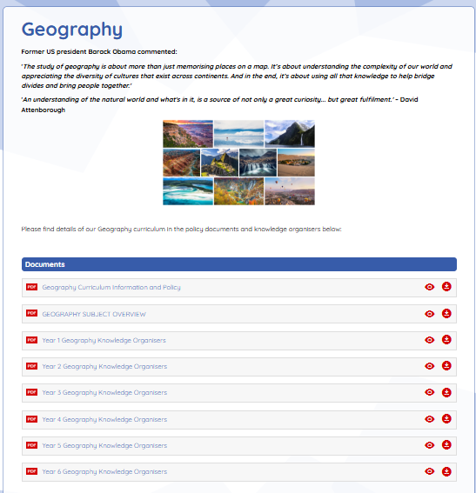

Notes:
AJ

Slide 17

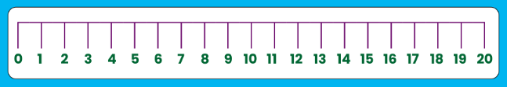
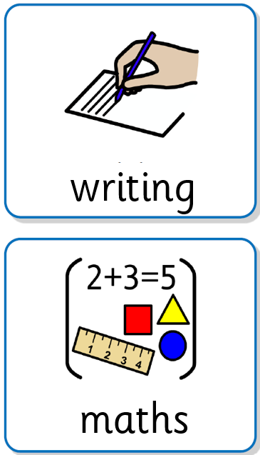
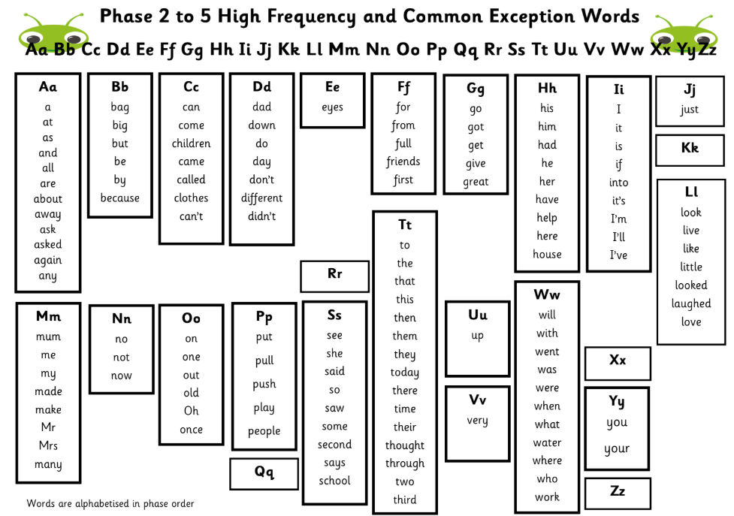
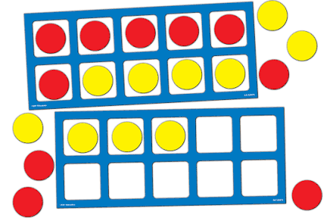

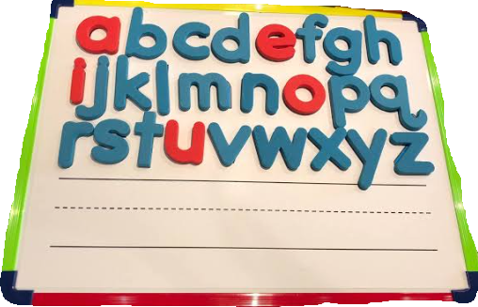
Adapting learning to support your child
Adaptations are made in the classroom to ensure all children can access the learning.
The Universal Adaptations document on the website
https://www.brookdaleprimaryschool.co.uk/Learning/SEND/
Word Mats
Dictated sentences
Key vocabulary displays
Targeted Intervention groups
Modelling
Scaffolding
Working Walls
Manipulatives
If your child is not able to access learning despite all of the adaptations, then they will have a learning support plan managed by the class teacher and the SENCo to support their learning further.
Notes:
AJ

Slide 18






RSE
Relationships Sex and Health Education
Families- celebrate different families
Friendships- a healthy friendship
Proper names for body parts- safeguarding
Parent zone
https://www.1decision.co.uk/resources/parent-carer-zone
Notes:
KK

Slide 19

Fundamental Skills
In each year group we ensure children understand and can apply the most fundamental skills before they move on to the next stage of learning. Otherwise any future learning will be like ‘building on sand’
For some children this means that they will need to revisit and receive additional intervention to help them master skills from previous year groups.
https://www.brookdaleprimaryschool.co.uk/English/
Notes:
KK

Slide 20
Fundamental Skills
Reading
Fundamental Skills
Word Meaning and
Decoding
Comprehension: Inference
Answers simple 'how' and 'why’ questions from pictures or text.
Discusses the actions of characters and
expresses views on the basis of what is being said and done.
Begins to make predictions based on what has been read so far
Checks that the
text makes sense
as they read and
corrects
inaccurate
reading.
Discusses word
meanings,
linking new
meanings to
those they
already know
Comprehension
Explains what is
read in their own
words.
Recalls main
points from
fiction and non-
fiction
Notes:
KK

Slide 21

Fundamental Skills
Writing
Sentence & Structure
● Uses finger spaces between
words.
● Sounds out words using phonics
● Uses capital letters for a start of a
sentence
● Uses full stops at end of sentence
● Writes a sentence that makes
sense grammatically
● Can read own writing aloud and
check for sense
Foundational Check
● Sits correctly (tummy to table)
● Holds pencil correctly (tripod)
● Forms Letters correctly (size
and orientation)
● Sounds out words using
phonics (phase 4)
● Uses standard English verb
inflections (we were not we
was)
Grammar & Vocabulary
● Adds -s or -es for plurals
correctly
● Use suffixes ing, er, ed and est
correctly
● Uses ? and ! correctly
● Joins words/clauses using “and”
● Uses capital letters for names,
places, days
● Use conjunctions - and
Notes:
KK

Slide 22
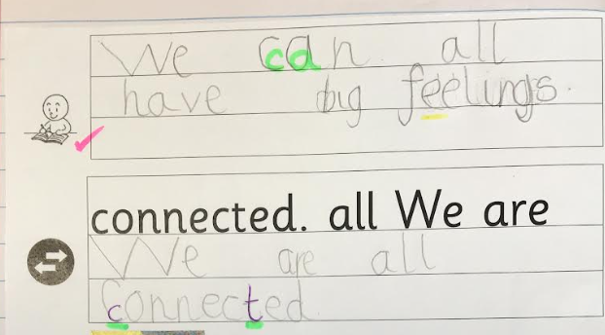
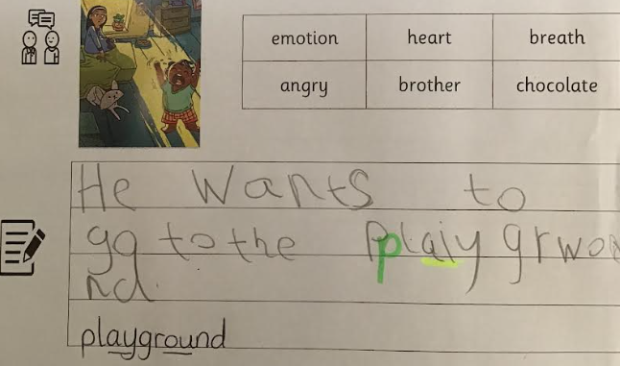
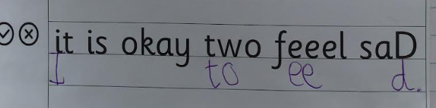
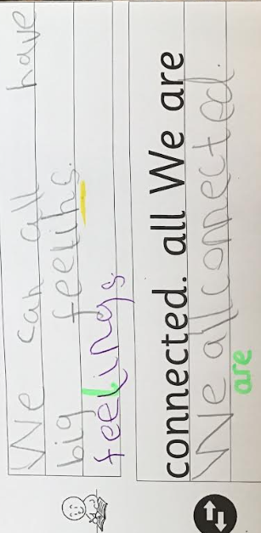
English - Writing
Notes:
KK

Slide 23
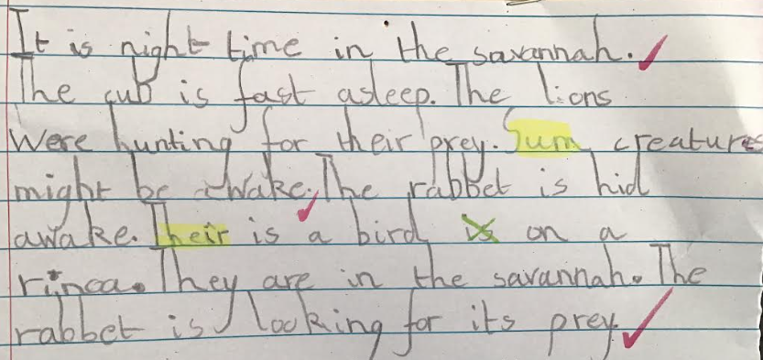
Notes:
KK

Slide 24

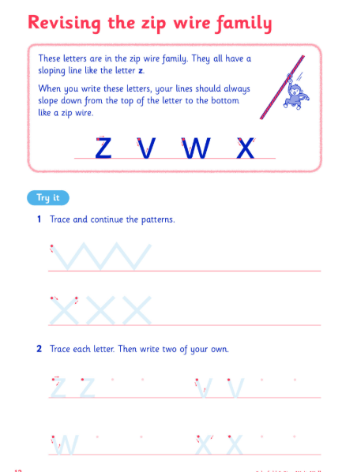
Handwriting
In Year 1, pupils should be taught to:
Sit correctly at the table, holding a pencil comfortably and correctly.
Begin to form lower case letters in the correct direction, starting and finishing in the right place.
Form capital letters.
Form the digits 0 to 9.
Understand which letters belong to which handwriting
‘family’ (a group of letters that are formed in the same way).
We have 3 lessons per week, 2 worksheet based and the 3rd
a dictated sentence into their handwriting books.
Notes:
KK

Slide 25
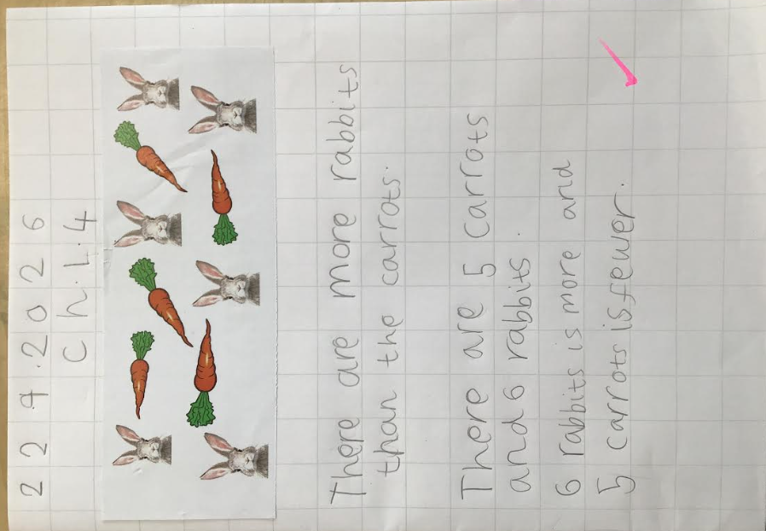
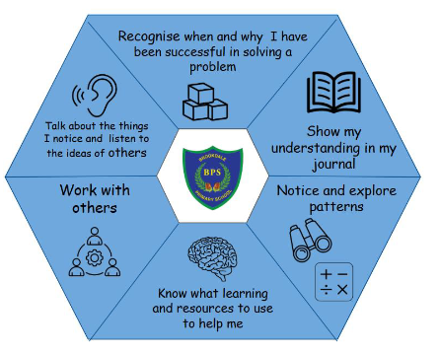
Maths
At Brookdale we use the Maths No Problem mastery scheme which helps the children develop their mathematical Fluency, Reasoning and Problem Solving. Every lesson follows the same structure,an explore task - to promote collaboration and investigation, structured discussions, practice and journaling/ workbooks. We also use a range of resources and hands on, real world context to support problem solving skills and deepen understanding.
Our maths curriculum policy and maths no problem website has more information and videos with support for parents.
Key stage end points:
Notes:
AJ

Slide 26
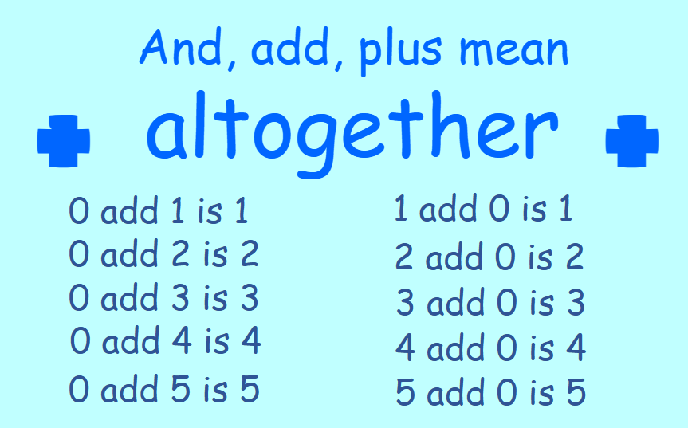
Maths Dictionary
Maths Dictionary is a way of learning key mathematical facts such as number bonds.
The children learn the words and actions from slides on the board that guide them through their ‘performance’.
The children are only expected to learn one new fact at a time and this is then added to the previous facts to build up a range of important mathematical facts.
Notes:
AJ

Slide 27
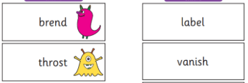
Assessment
We assess the children in:
Writing
Reading
Maths
Science
These areas are assessed throughout the year with outcomes used by teachers to inform next steps in their teaching.
The Phonics Screening Check is a short, statutory assessment taken by pupils at the end of Year 1 to evaluate their decoding and word-reading skills.
They read a list of 40 words out loud using their letter sounds. The check helps to ensure any children needing extra reading support are further identified.
Notes:
AJ

Slide 28

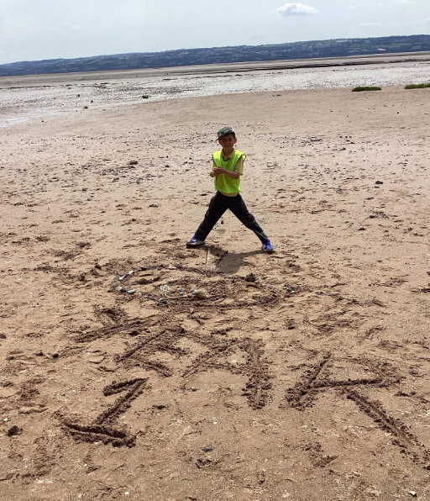
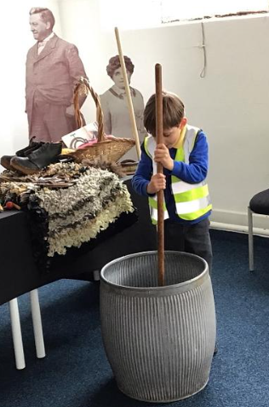
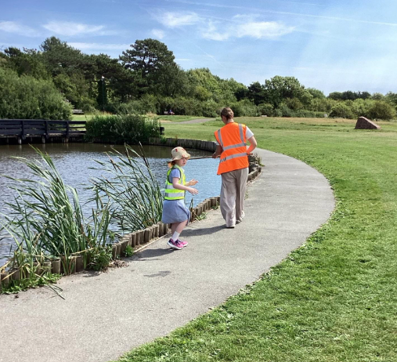
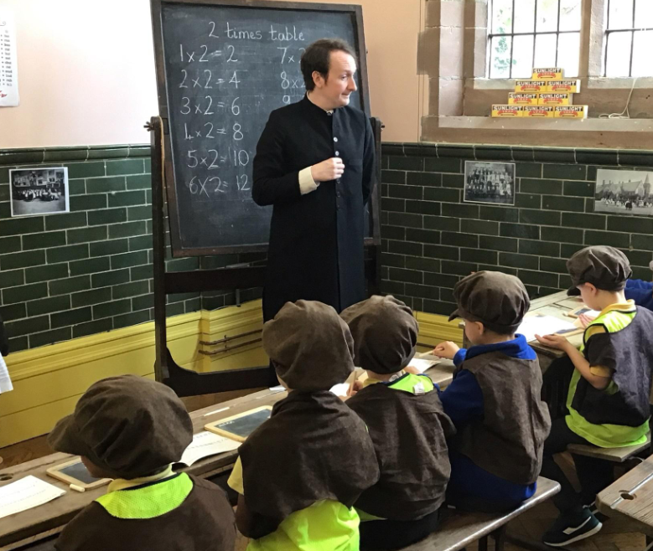
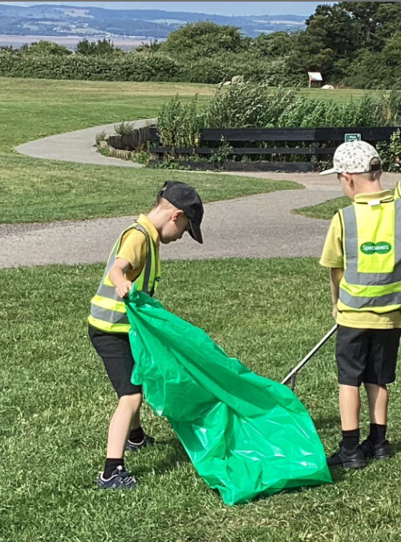
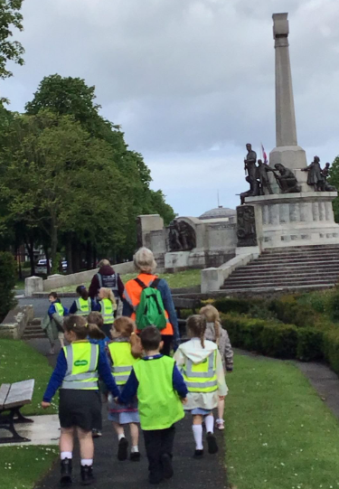
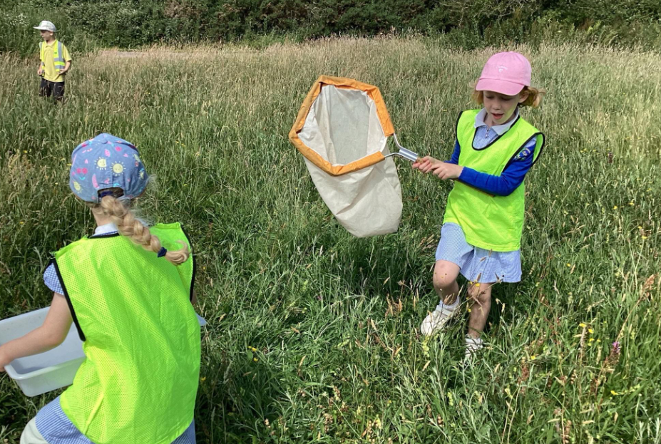
Trips
Port Sunlight
Thurstaston
During are trips we expect children to represent our school in the local community dressed in school uniform and showing good behaviour. We use the school grounds to extend learning and invite visitors in to share their experiences or expertise.
Parents will be informed via email about a big class trip a few weeks before it is due to happen and how to make payment (if required).
Notes:
KK

Slide 29
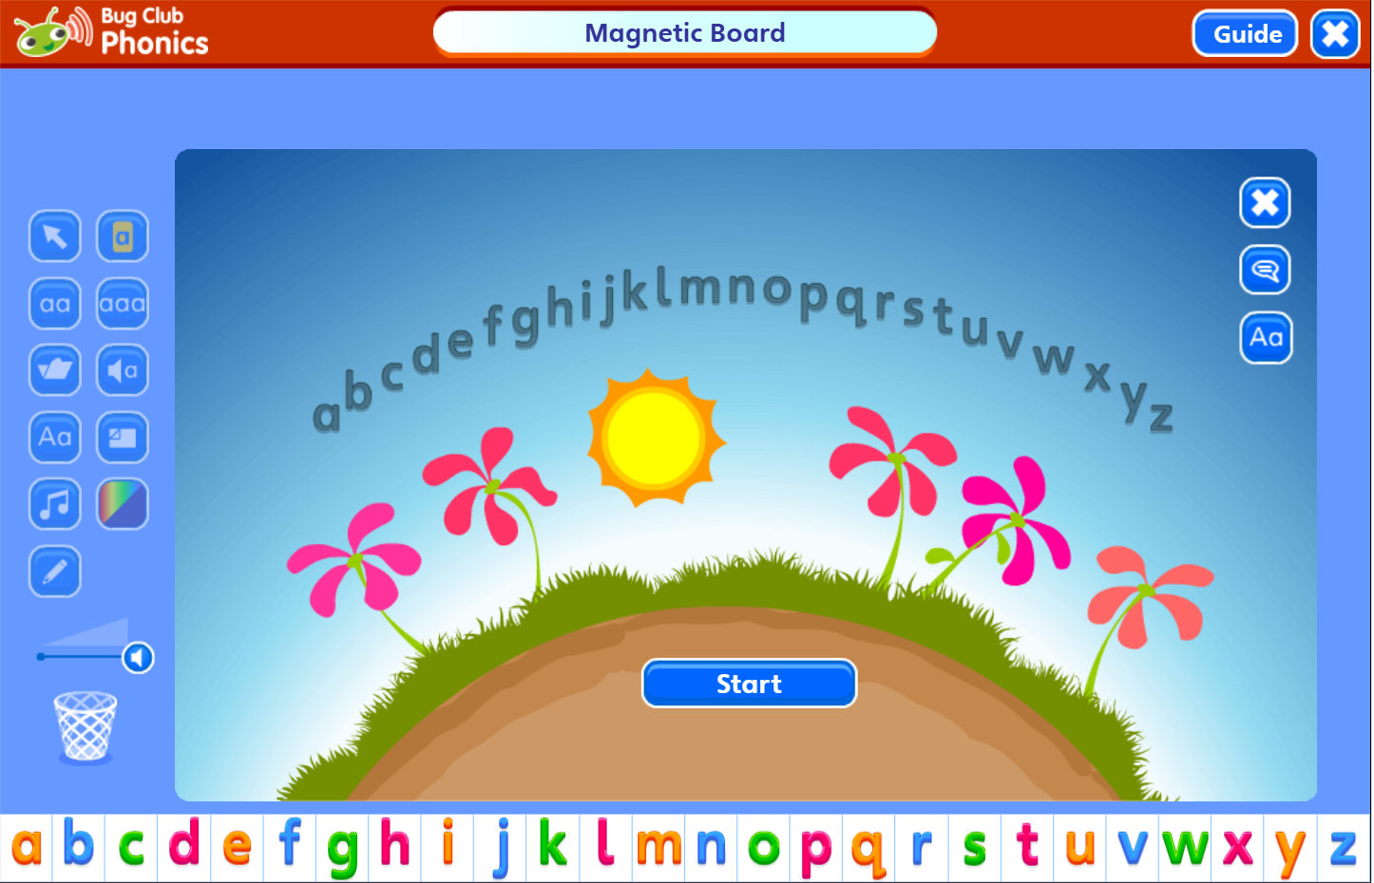
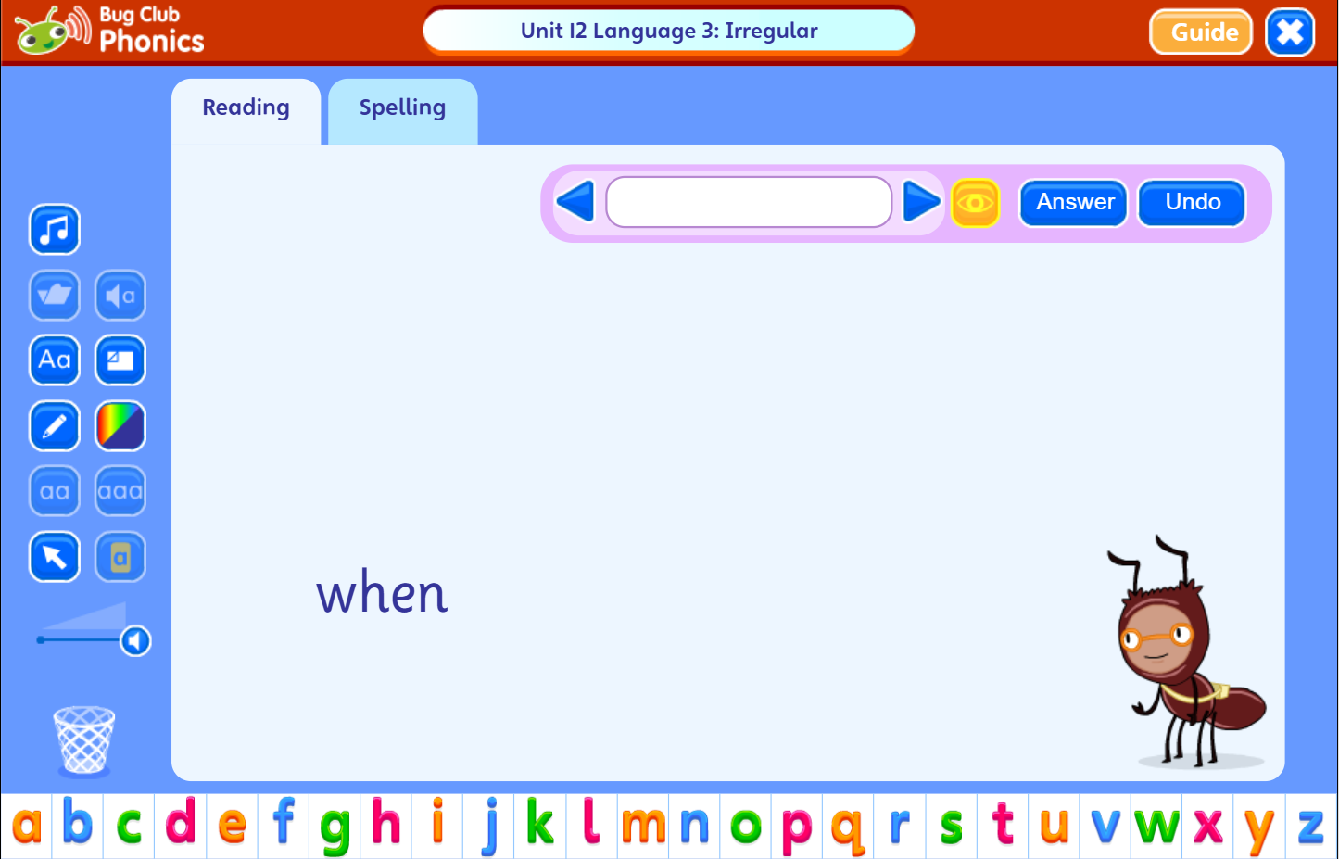
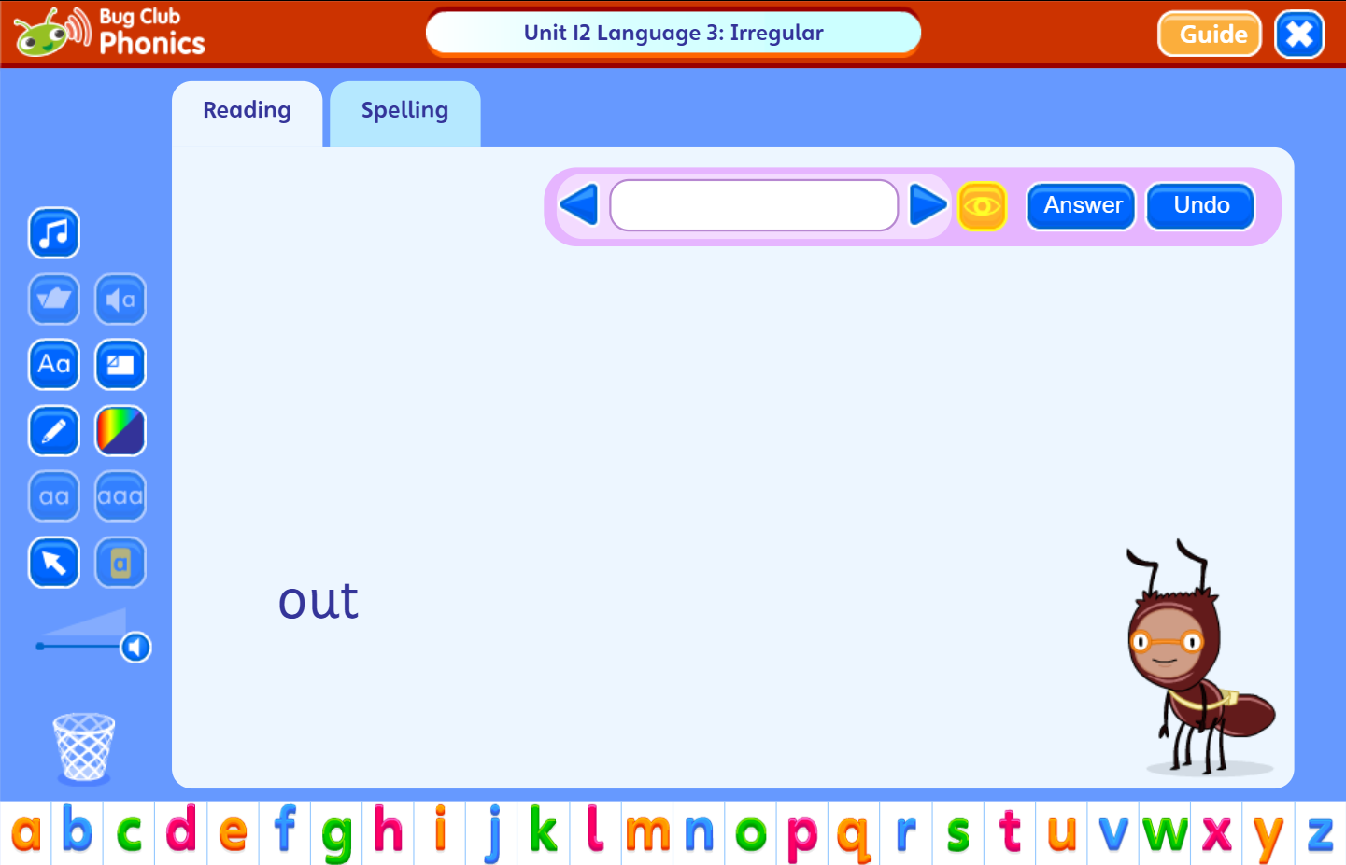
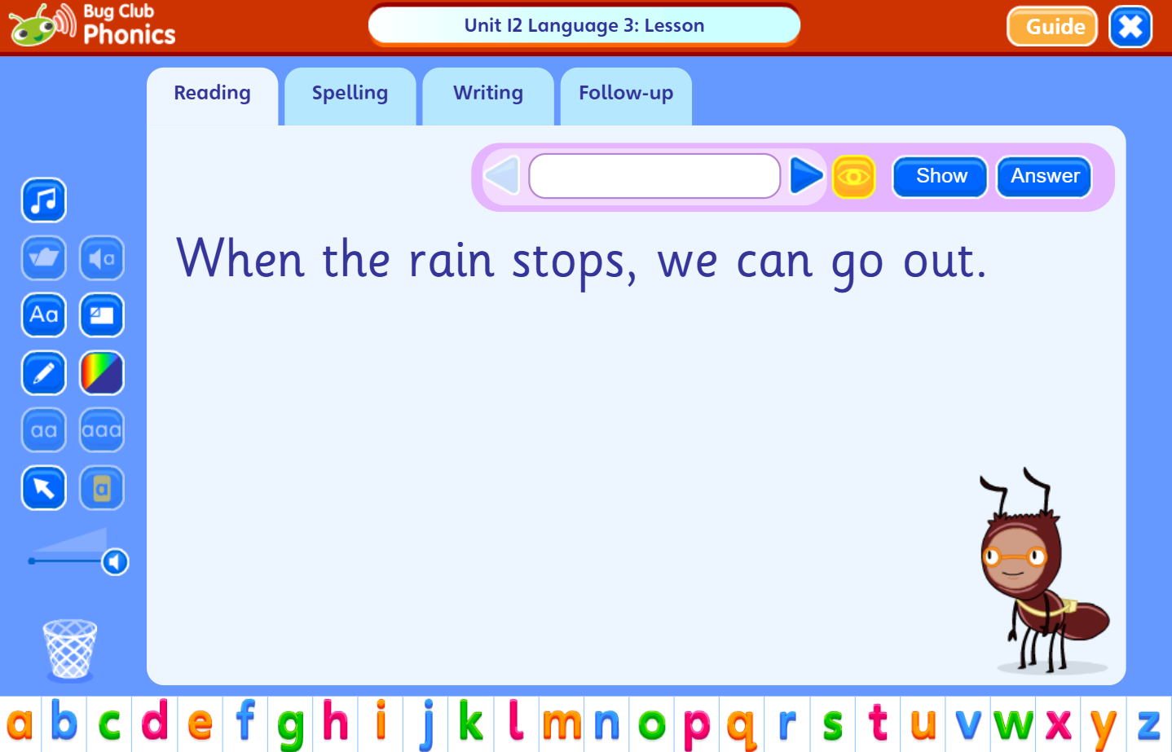
Teaching Session
-

