Slide 1

Preschool
Curriculum Morning 2026

Slide 2
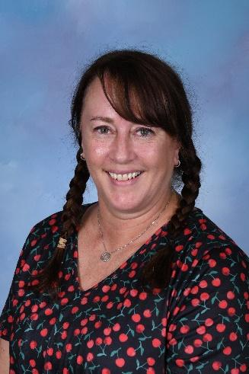
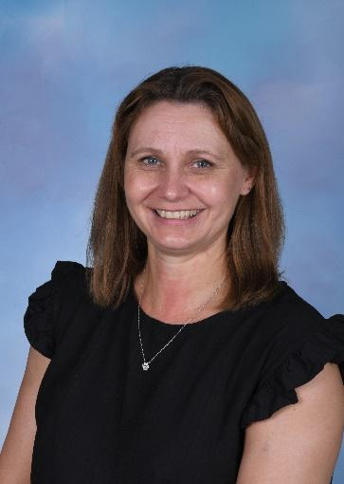
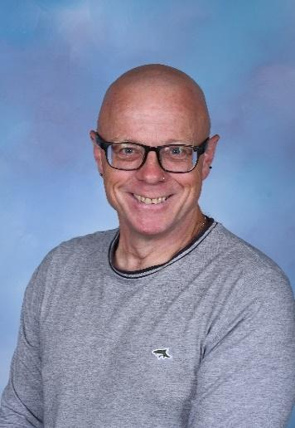
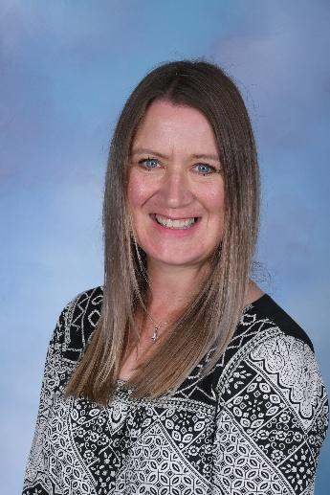

Pre-school Staff
Mrs Doig, Mrs Lloyd, Mr Knapton, Mrs Lloyd and Mrs Goodchild

Slide 3
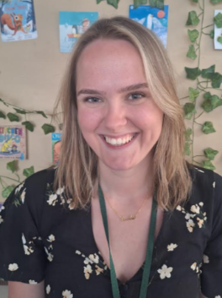
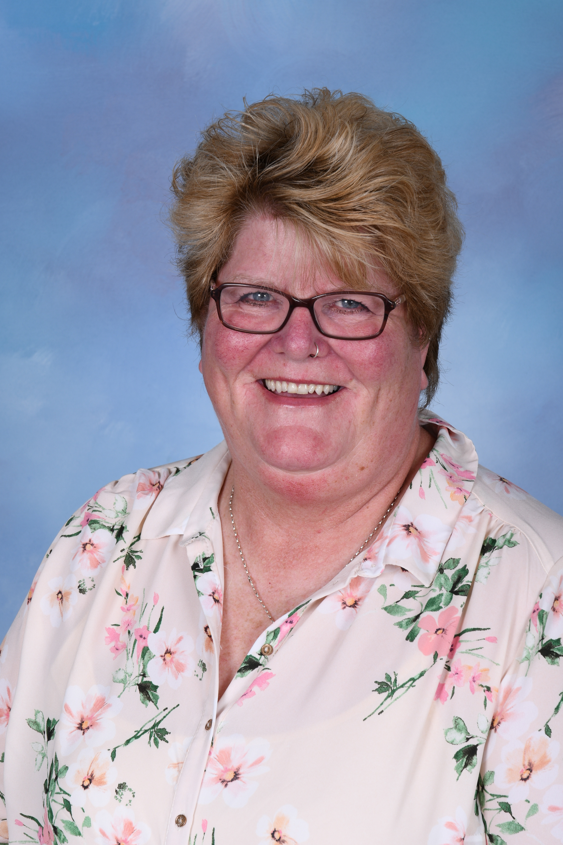
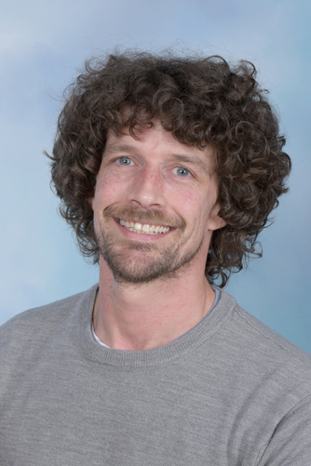
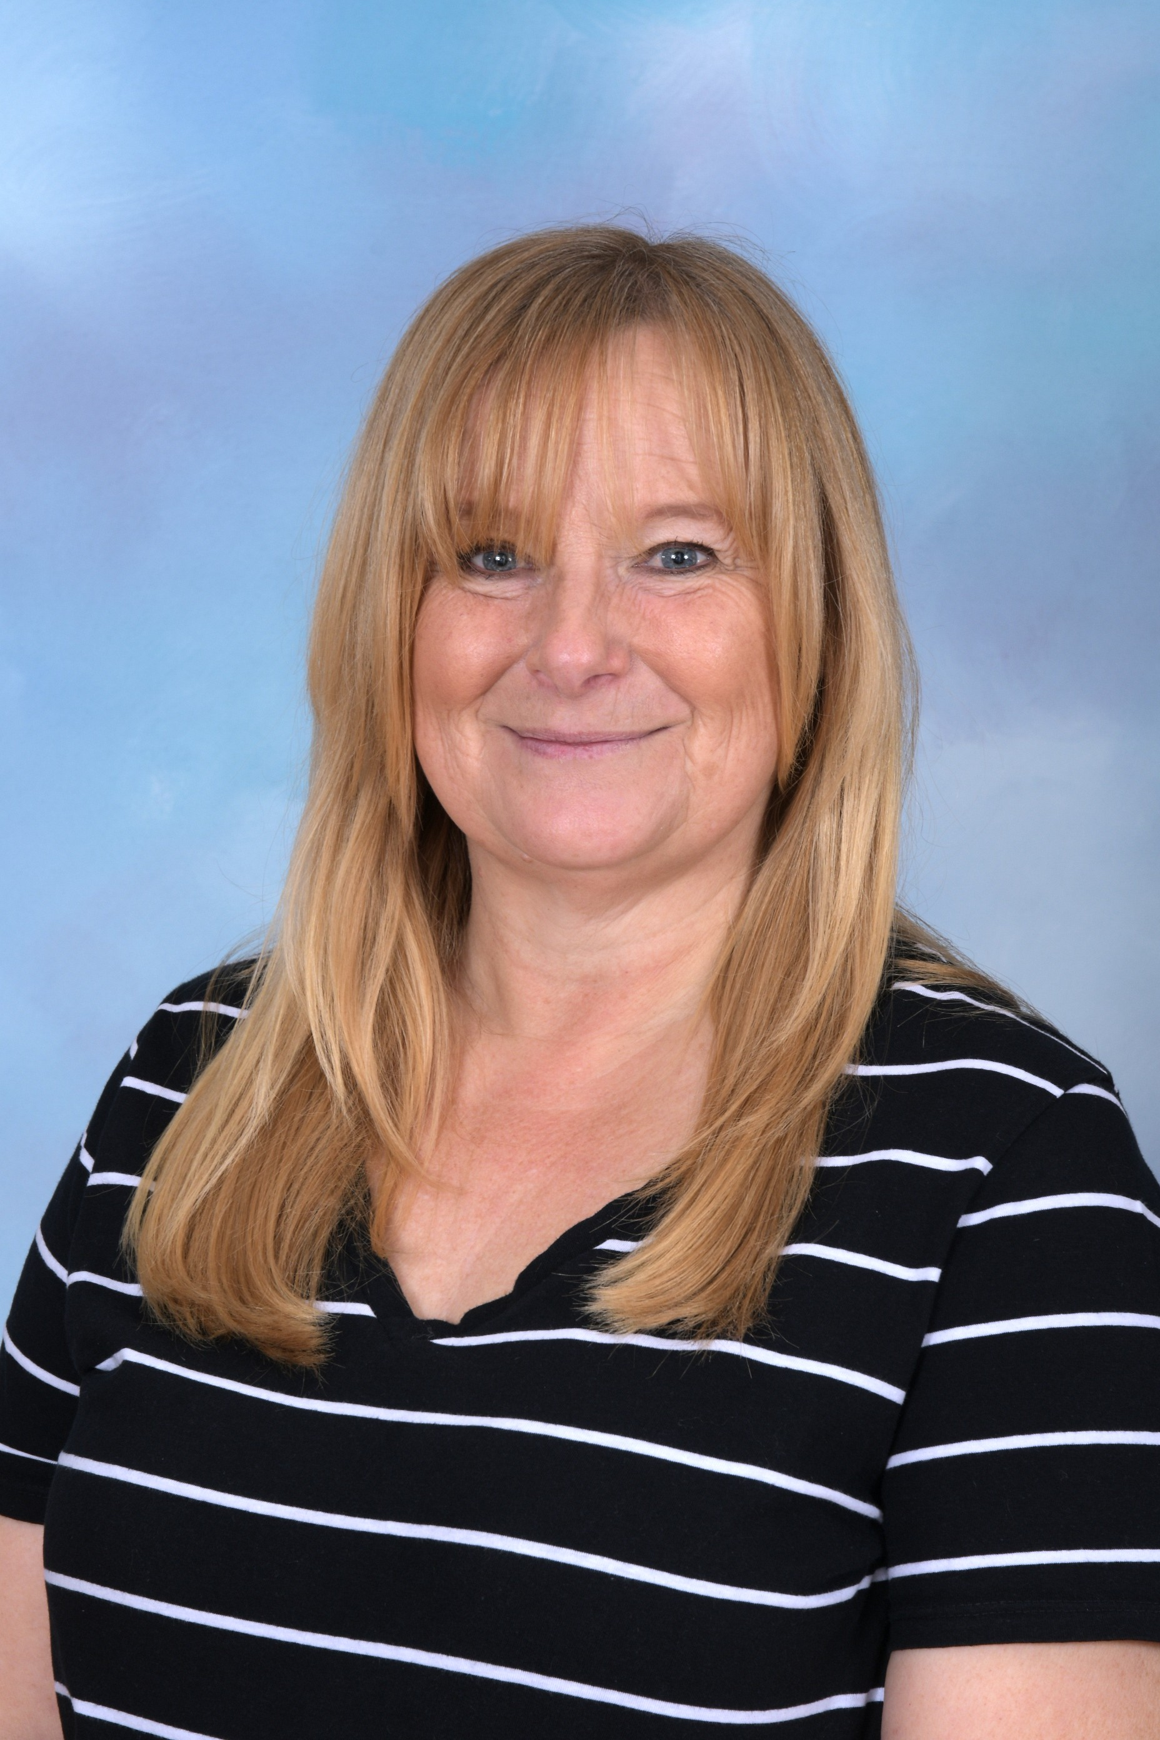
The children may talk about other grown ups – Mrs Jackson, Mrs Jones, Mr Kirby and Mrs Pleavin-Lee.

Slide 4
Expectations
School Vision Statement
Inspiring, engaging and nurturing our children to achieve and flourish as citizens of today and the future.
School Core Values
Teamwork, Responsibility, Respect, Compassion, Friendship, Determination
Attitudes & Effort
At Brookdale, we encourage our children to work hard and to always try their best. We instil the message that it is OK to struggle, be stuck and to make mistakes; it is the way they become ‘unstuck’ that matters.

Slide 5
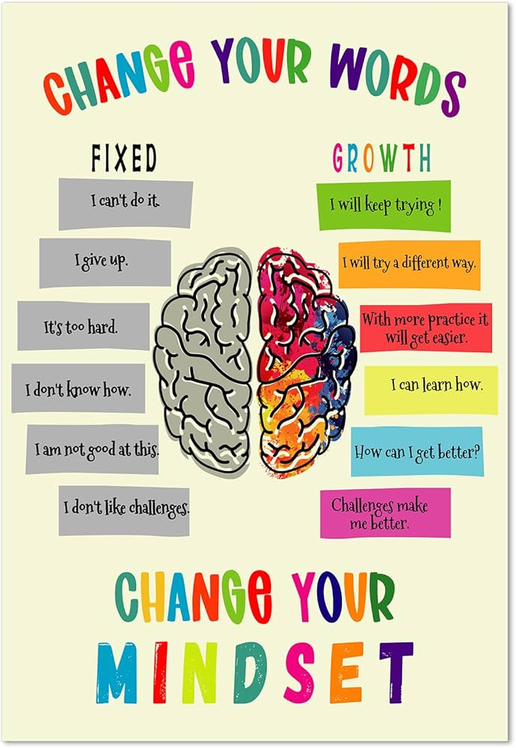
Growth Mindset
A growth mindset is believing that your brain can grow and you can learn new things. Mistakes are part of learning and it is important to be brave and practice new learning.
A fixed mindset is believing you are either clever at something, or not and you cannot change this.

Slide 6
Behaviour and Rewards
When a pupil’s behaviour meets, or goes above and beyond, the expected behaviour standard, staff will recognise it with positive recognition and reward. This provides an opportunity for all staff to reinforce the school’s culture and ethos.
Positive reinforcements and rewards will be applied clearly and fairly to reinforce the routines, expectations and norms of the school’s behaviour culture.
Positive behaviour will be rewarded with such things as:
Verbal praise
Dojo Points
Communicating praise to parents/carers

Slide 7
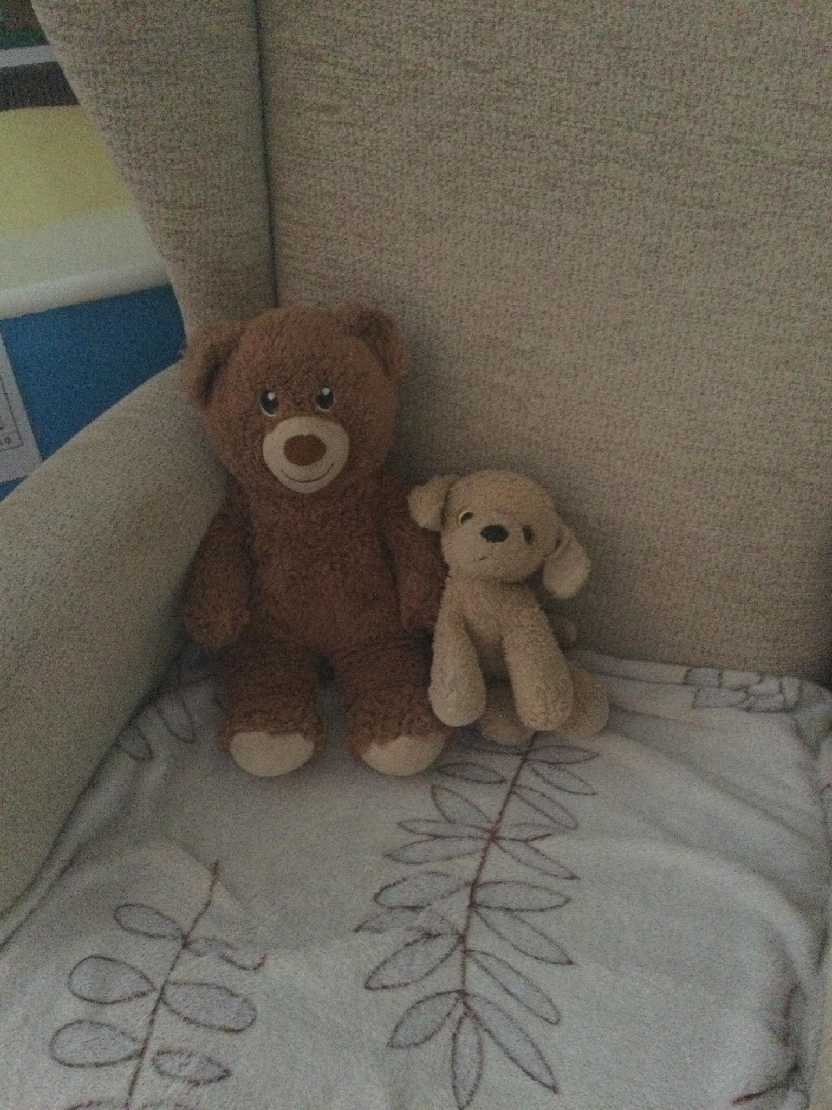
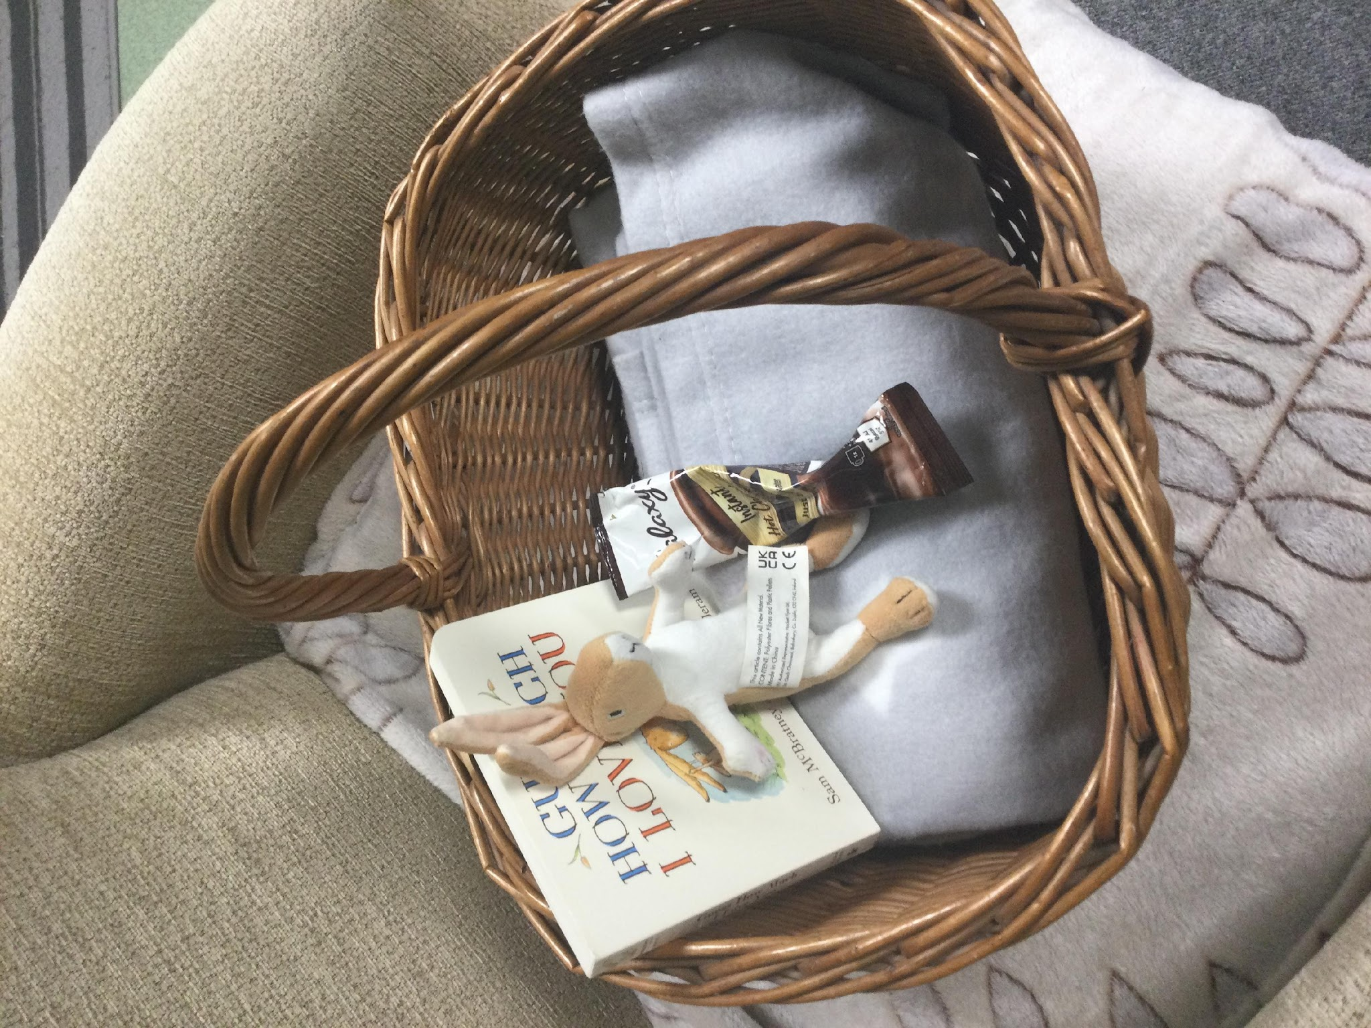
Behaviour and Rewards
Dale Bear and Brook the Dog
Bedtime story basket

Slide 8

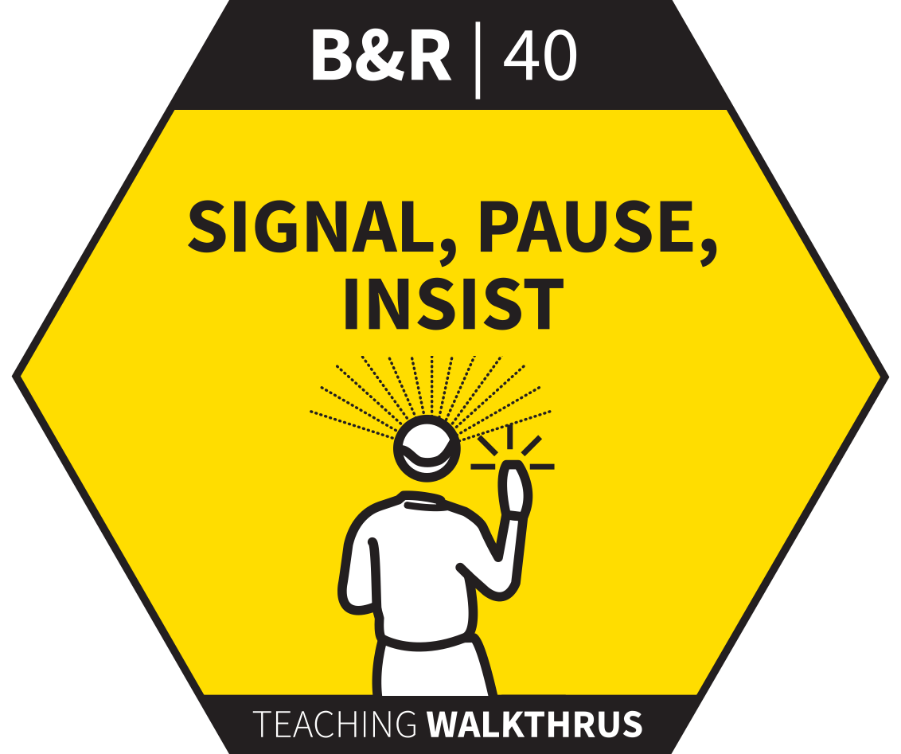
Teaching Strategies
Gradually introduce cold calling, show me boards, talking partners.

Slide 9
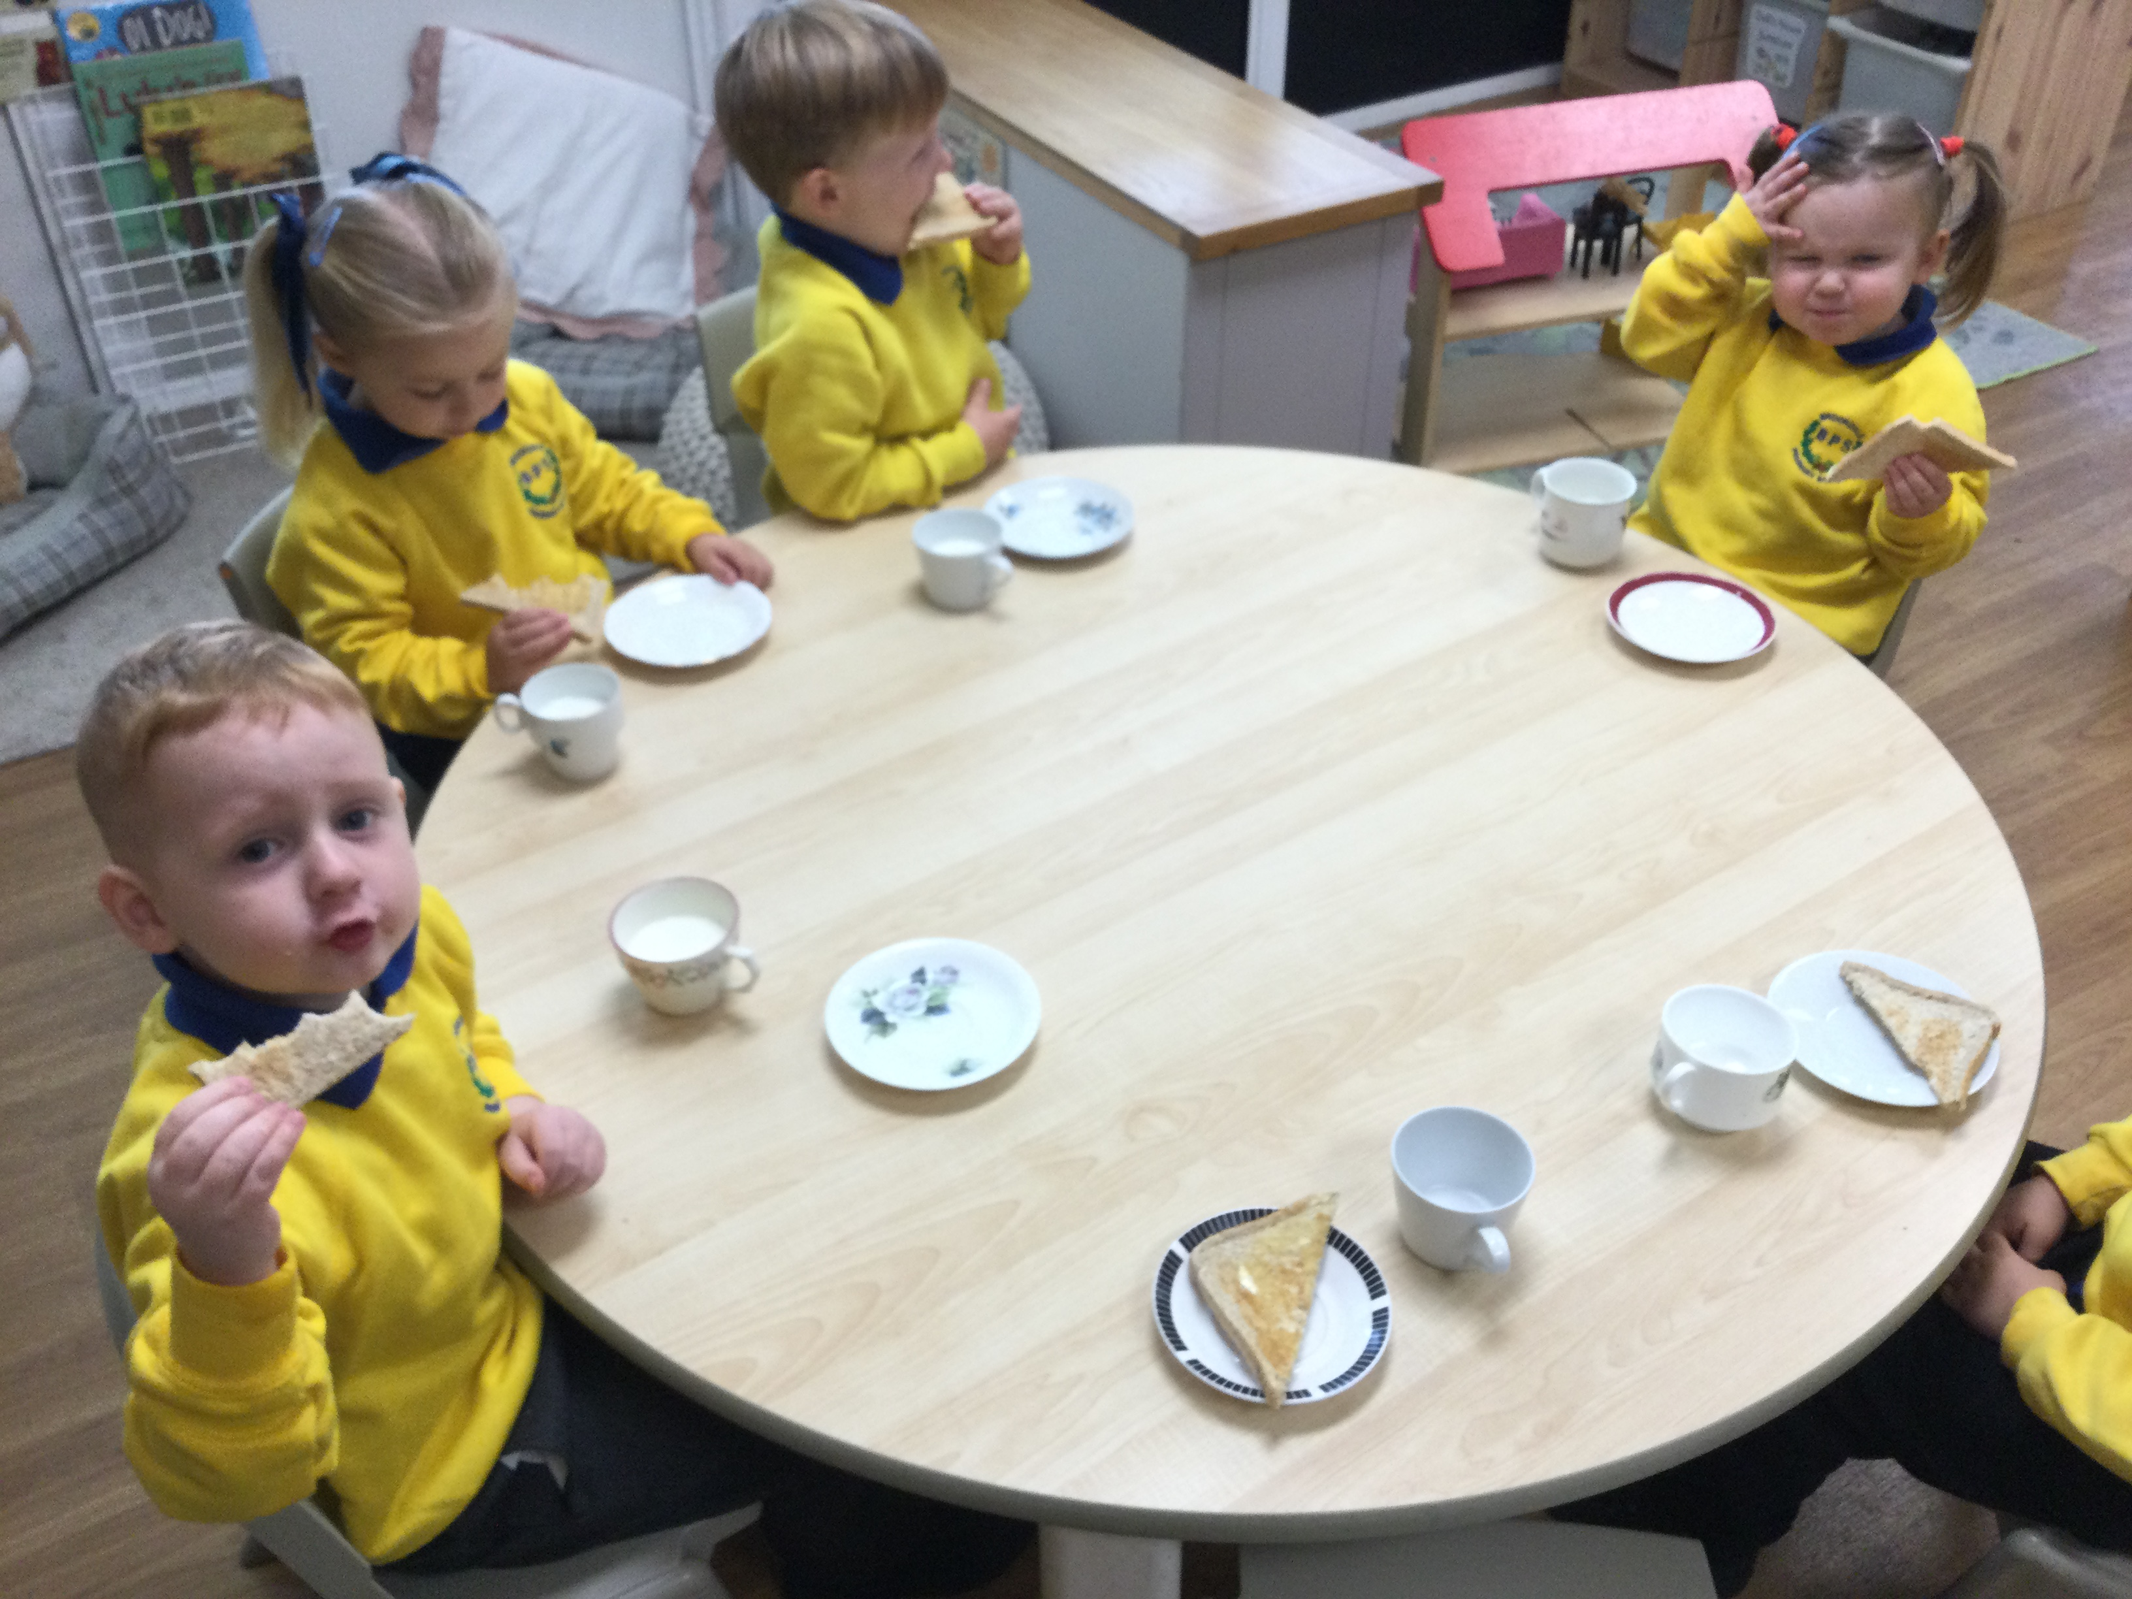
Typical Day
8.35 to 8.45 am drop off – morning jobs to support fine motor skills. We then start the day together
The day is then split into:
  busy time both indoors and outdoors
  short together time activities with a focus on phonological awareness, personal, social and emotional development mathematical skills
  physical activities either in the hall or outside
  rhythmic movement therapy activities
Story time, rhymes and songs– both morning and afternoon
Morning snack– toast and milk/water, afternoon snack - fruit – Snack time is used as an opportunity to develop personal and social skills.

Slide 10
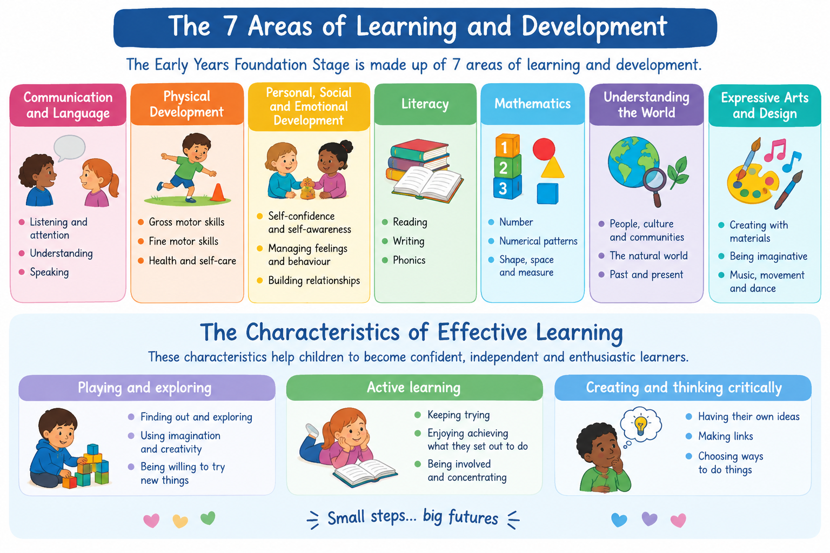

Slide 11
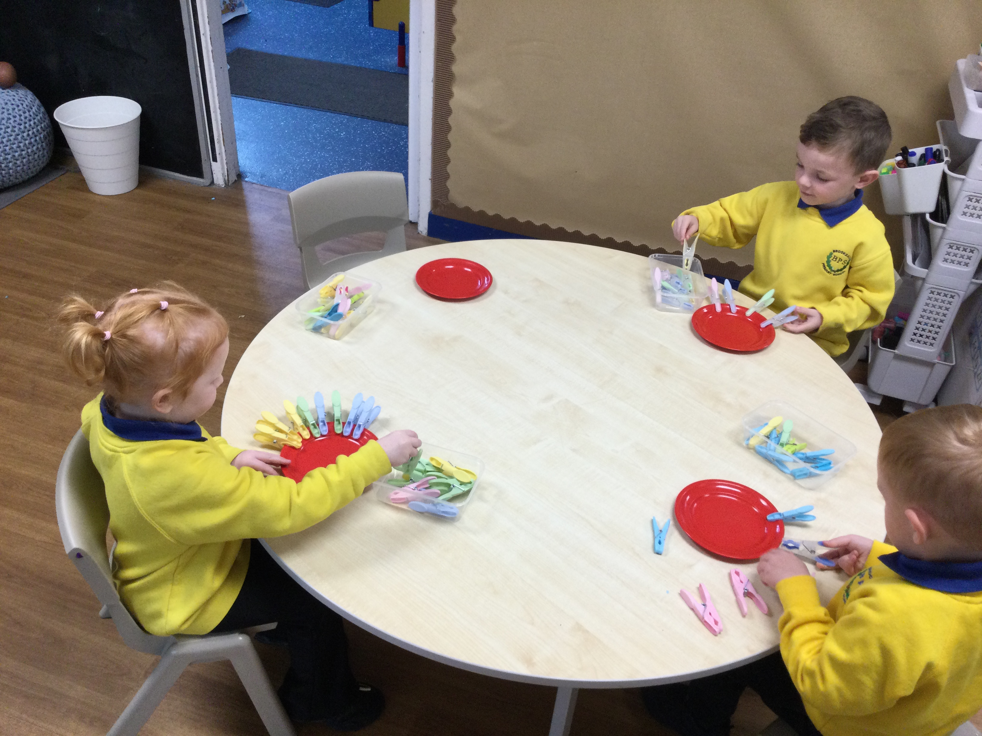
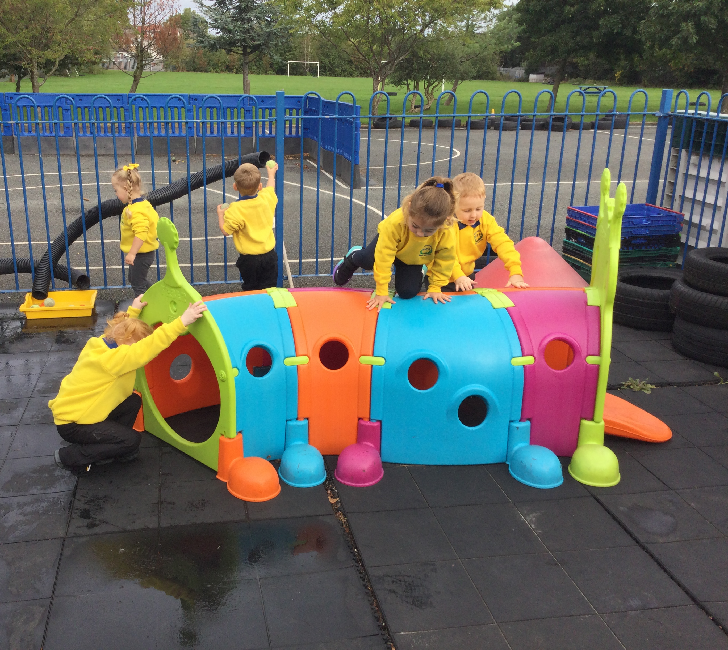
Curriculum Information
The preschool curriculum is delivered by planning quality provision for play opportunities. It is created to be holistic and ambitious and sets up what we intend the children to learn and experience across all 7 areas of learning.
It is tailored to the age and development stages of all children, as well as drawing upon their interests and supporting their individual needs.
All practitioners will spend time listening, observing, scaffolding and facilitating the children to challenge themselves and move learning forward.
Each week, we will share information on the experiences and activities the children will be offered through our class story on Dojo.
At the end of each week, we will share photographs and updates highlighting the children’s learning, activities and achievements, giving you a little insight into their experiences at preschool.

Slide 12



Big Questions
What makes me special?
How do I look after myself?
Who could help?

Slide 13

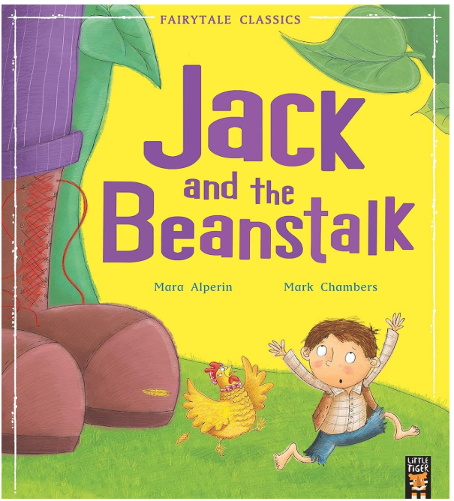
Early Reading
Language comprehension (necessary for both reading and writing) starts from birth. It only develops when adults talk with children about the world around them and the books (stories and non-fiction) they read with them, and enjoy rhymes, poems and songs together.
Adults can talk about why they like a book and share what the child likes too. You should let them explore how books open, while talking about what they see or feel. Be patient, letting them ask or answer questions.
Visit school library weekly and borrow books to take home
Focused texts which are shared daily
Rhyme and song bags
Story bags
http://www.lovemybooks.co.uk/
https://www.booktrust.org.uk/

Slide 14
Building Skills Through Everyday Learning
Makaton Sign of the Week – Supports children’s communication by giving them another way to express their needs, ideas and feelings while developing their understanding of language.
Concept Cat Word of the Week – Helps children build a rich vocabulary and develop their understanding of important words and concepts that support learning across the EYFS.
Think Equal – Helps children develop empathy, self-awareness, positive relationships and an understanding of themselves and others, celebrating similarities and differences.

Slide 15
What does school readiness look like in Preschool?
School readiness is about developing the skills children need to feel confident, happy and ready to learn — not about being able to read or write before starting school
💬 Communication
Listening and responding
Expressing needs and ideas
Joining in conversations
🧡 Independence
Toileting and handwashing
Putting on coat and shoes
Looking after belongings
🌱 Self-regulation
Managing feelings with support
Following simple routines
Waiting, sharing and taking turns
🏃 Physical skills
Moving safely and confidently
Developing fine-motor control
Using tools and equipment
🤝 Relationships
Building friendships
Playing alongside and with others
Feeling secure with familiar adults
🔎 Curiosity & learning
Exploring and asking questions
Trying new things
Concentrating and persevering
✨ Ready to learn
Enjoying stories, songs and rhymes
Following instructions
Having a go and being proud of achievements

Slide 16
Rhythmic Movement Therapy (RMT)
Building strong foundations for learning, movement and self-regulation in the Early Years
What is RMT?
RMT uses simple, rhythmic movement patterns such as rocking, crawling, rolling and cross-lateral movements.
The activities are playful, repetitive and developmentally appropriate.
They give children opportunities to practise movement, balance, coordination and body awareness.
At preschool, we use RMT-inspired activities as part of our wider physical development and regulation provision.
Why movement matters
Young children learn through their whole body as well as through talk and play.
Movement supports the development of posture, balance, coordination and motor planning.
Physical activity can also help children become ready to listen, engage and take part in learning.
These foundations support later skills such as mark-making, writing, sitting comfortably and using tools.
A gentle reminder
RMT is one part of our EYFS approach — not a replacement for specialist therapy or professional assessment.
Children develop at different rates, so activities are adapted to individual needs.
The aim is to make movement enjoyable, successful and part of everyday learning.

Slide 17

The theory behind the movement
RMT draws on the idea that early movement experiences help children build the foundations for later motor and learning skills.
Vestibular system
Our balance and movement system.
Movement such as rocking, spinning, jumping and balancing gives children opportunities to notice how their body moves through space.
This can contribute to body awareness and postural control.
Proprioception
Our 'body awareness' system.
Pushing, pulling, crawling, carrying and climbing provide resistance and feedback from muscles and joints.
This helps children understand where their body is and how much force to use.
Cross-lateral movement
Movements that encourage the left and right sides of the body to work together.
Examples include opposite hand-to-knee touches and crawling patterns.
These activities practise coordination, sequencing and motor planning.
Rhythm & repetition
Predictable movement patterns can help children practise a skill repeatedly.
Songs, clapping, marching and movement stories make this fun and memorable.

Slide 18


Why is this important in EYFS?
Physical Development is one of the seven areas of learning — and movement supports many other areas too.
🏃 Physical development
Balance and coordination
Gross and fine motor foundations
💬 Communication
Action songs and movement stories
Listening and responding
🧠 Self-regulation
Movement breaks
Recognising and responding to body signals
✏️ Future learning
Postural control
Hand strength and coordination
🤝 Social development
Turn-taking
Moving safely with others
🔎 Learning
Attention and engagement
Trying, repeating and problem-solving
🌟 What this looks like in preschool
Short movement activities woven into the day
Climbing, balancing, running and jumping
Crawling, rolling, animal walks and cross-lateral games
Movement stories, music, dancing, yoga and action rhymes

Slide 19
Some of the RMT activities we do
Short, playful activities can be built into the day — no special equipment is needed for many of them.
🐻 Animal movements
Bear walk
Bunny hops
Frog jumps
Crawling
Combat crawl
Encourage children to move slowly, steadily and with control.
🔄 Whole-body patterns
Rolling in different directions
Rocking forwards and backwards
Opposite hand to knee
Marching with big arm movements
Reaching across the body
Keep repetitions short and enjoyable.
🎈 Fun with equipment
Balloon taps
Hoops to step, jump or crawl through
Elastic-band pulling
Beanbag or ball games
Balance activities
Use safe, age-appropriate equipment and close supervision.
🎵 Rhythm
Clapping patterns
Marching
Action songs
Movement stories
Freeze and go
Dance
We keep activities short, playful and achievable — the quality of the movement matters more than doing lots.

Slide 20
What can parents do at home?
You don't need a programme or special equipment — everyday movement is a wonderful way to build strong foundations.
Move together
Have a daily dance or action-song session.
Play 'Simon Says' with big movements.
March, jump, hop and balance together.
Try animal walks across the room or garden.
Play on the floor
Build with blocks, crawl through tunnels or under tables.
Roll a ball backwards and forwards.
Try rolling like a log on a safe surface.
Use cushions for climbing, crawling and balancing with supervision.
Build independence
Let your child carry, push, pull and tidy safely.
Encourage dressing, shoes and coat practice.
Use playdough, threading, drawing, cutting and building to strengthen hands.
Most importantly: keep it fun and stop if your child becomes tired or uncomfortable.
Little bursts of movement, repeated often, can make a big difference.

Slide 21
Assessment
Ongoing observations during play and routines
Adults watch, listen, and interact naturally with children
Supports planning and adapting activities to suit individual development
Focuses on the whole child – not just what they “know”
Parents are partners – your observations and input are valuable
Wellcomm assessment - helps us check speaking, listening, and understanding skills
2 Year progress check

Slide 22

Useful Links
Hungry Little Minds
Tiny Little People
Wirral School Readiness
What to expect when
Book Trust
Physical Activity

